Slide 1
Physical Activity
Notes:
Introduce topic: Physical Activity

Slide 2
Learning Objectives
Understand the importance of regular physical activity. ​
Learn about proper nutrition for game day​.
Critically evaluate supplements.
Notes:
Go over the learning objectives. Hand out the Physical Activity Worksheet for students to fill out while watching the presentation.

Slide 3

Fact or Fiction?
Regular physical activity is only important for
people with diabetes.
Notes:
Fact or Fiction? Read statement. Answer: FICTION!
Because...next slide

Slide 4
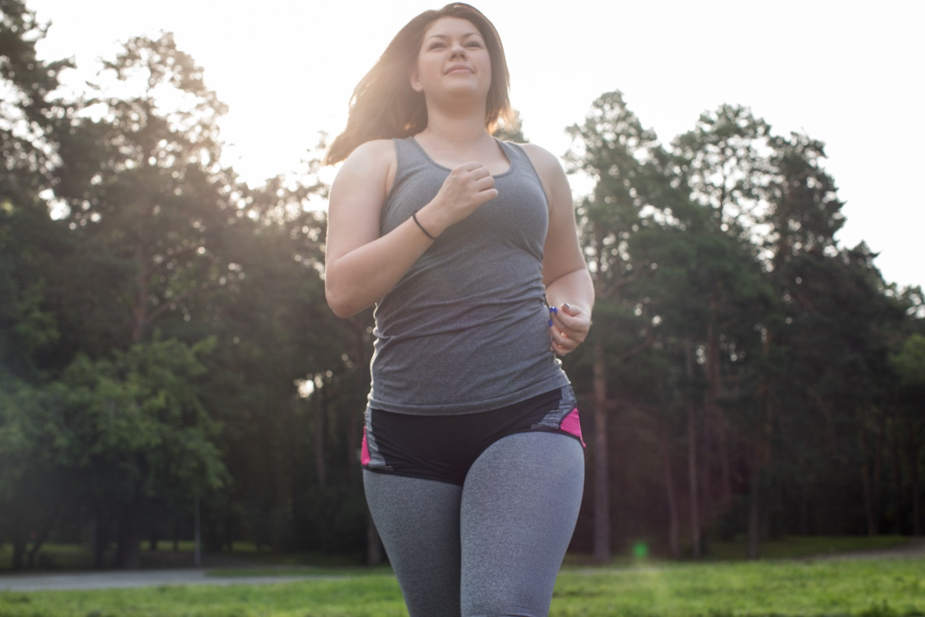
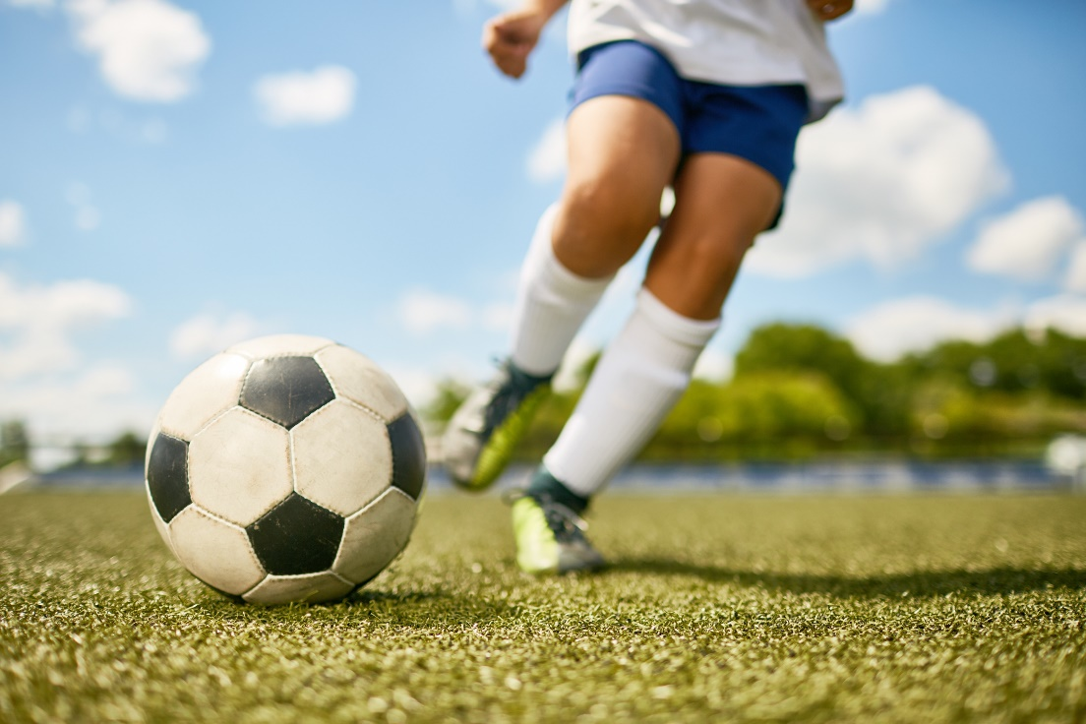
Why be Physically Active?
Improves self-esteem and mood
Helps prevent chronic disease
Encourages bonding with family members and friends
Builds strong bones and muscles
Promotes a healthy weight
Promotes life-long wellness and health
Notes:
What is so Important about being physically active? Physical activity is important for everyone because it helps improve cardiovascular health, helps promote or maintain a healthy weight, encourages bonding with family members and friends, builds strong bones and muscles, and reduces the risk of chronic diseases. Additionally, regular physical activity can enhance mental well-being, boost mood, and improve overall quality of life.

Slide 5

What is a healthy
breakfast?
Physical Activities That
Matter
Joana Alexa
St. Peternburg,USA
@joanaalex
+61 2435 2654
Dean – Nutrition College Student
https://health.utah.edu/nutrition-integrative-physiology
/community-outreach/utah-center-community-nutrition
/clinical-nutrition-resources
ipsum volutpat tincidunt dapibus at integer eleifend nulla dictum pellentesque lacus vitae tristique nullam malesuada nulla seds massa
Notes:
Play video: Dean- Physical Activities Matter

Slide 6
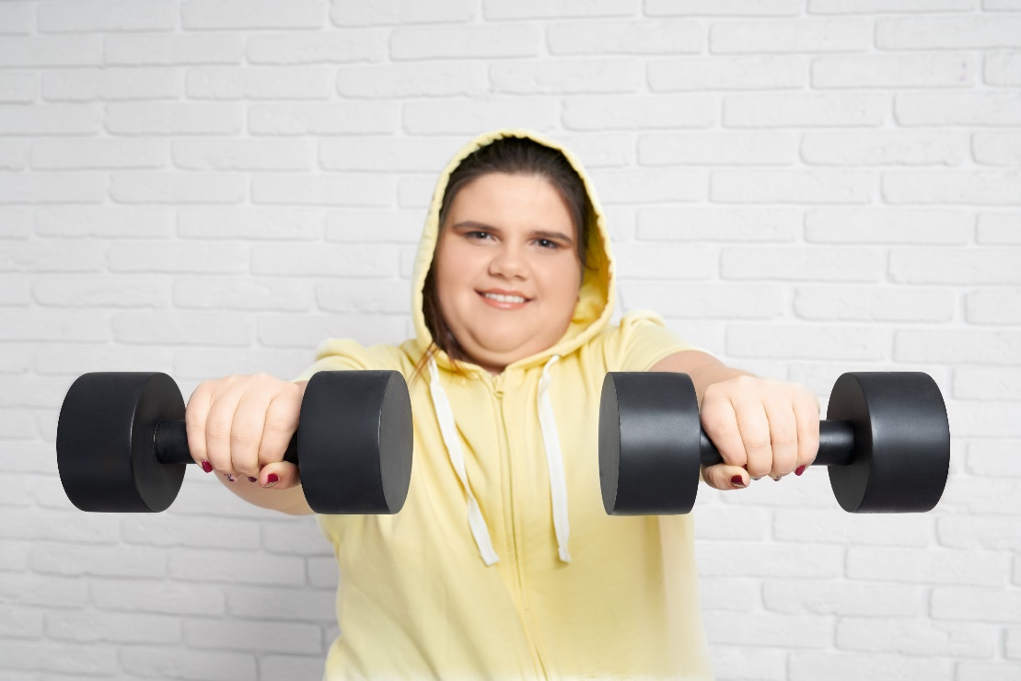
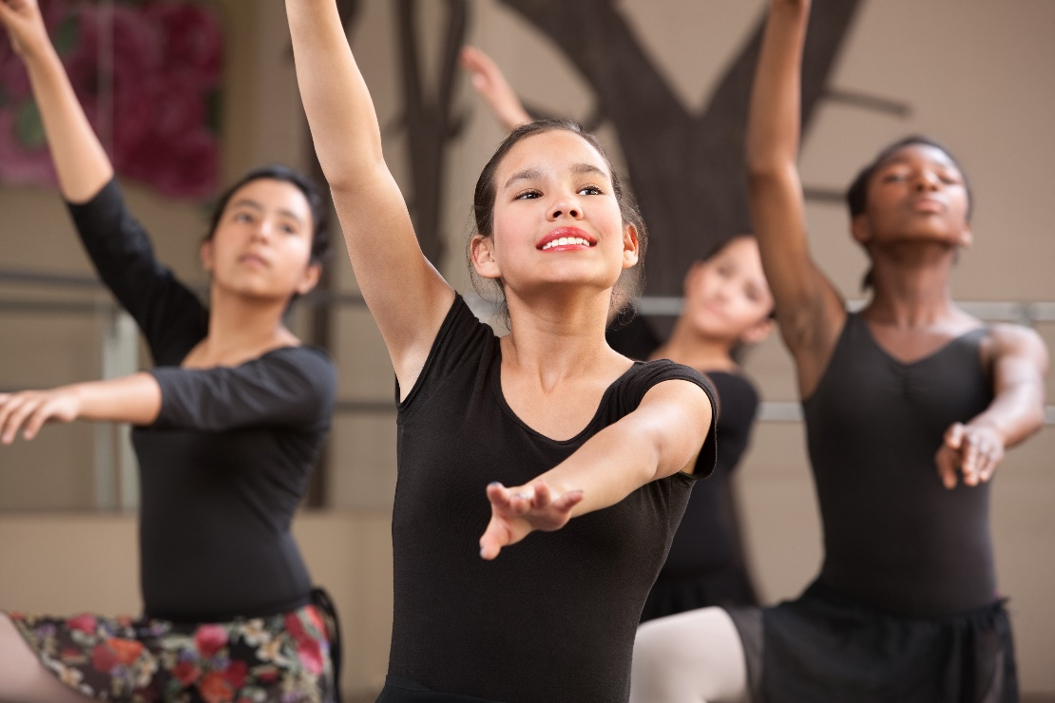
Physical Activity Guidelines
60 minutes or more of moderate to vigorous activity daily
  Aerobic - Most of the 60 minutes
  Muscle-strengthening - As part of aerobic activity/3 days a week
  Bone-strengthening - As part of aerobic activity/3 days a week
Notes:
The Centers for Disease Control and Prevention recommends that children and adolescents aged 6-17 engage in at least 60 minutes of moderate to vigorous physical activity each day. This should include a combination of aerobic activities (such as running or swimming) and muscle-strengthening activities (such as push-ups or jumping jacks).

Slide 7
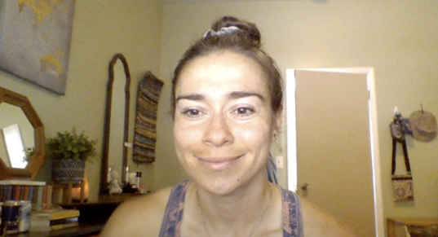
Do Something You Enjoy
and Get More Activity
Throughout the Day
Take the stairs
Ride your bike to school
Help with chores
Take your dog for a walk
Be more aware of moving throughout the day
Danielle – Nutrition College Student
https://health.utah.edu/nutrition-integrative-physiology
/community-outreach/utah-center-community-nutrition
/clinical-nutrition-resources
Notes:
Most importantly, do something that you enjoy for physical activity and do things through out that day that will get you more movement; read through bullet points.
Play video: Danielle- Get More Activity.

Slide 8
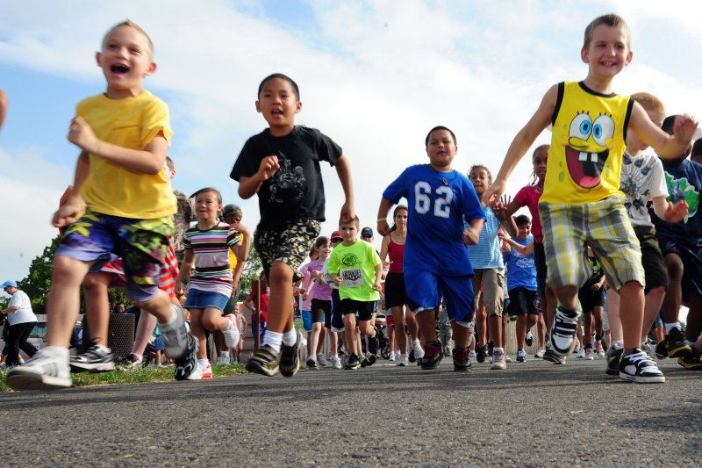
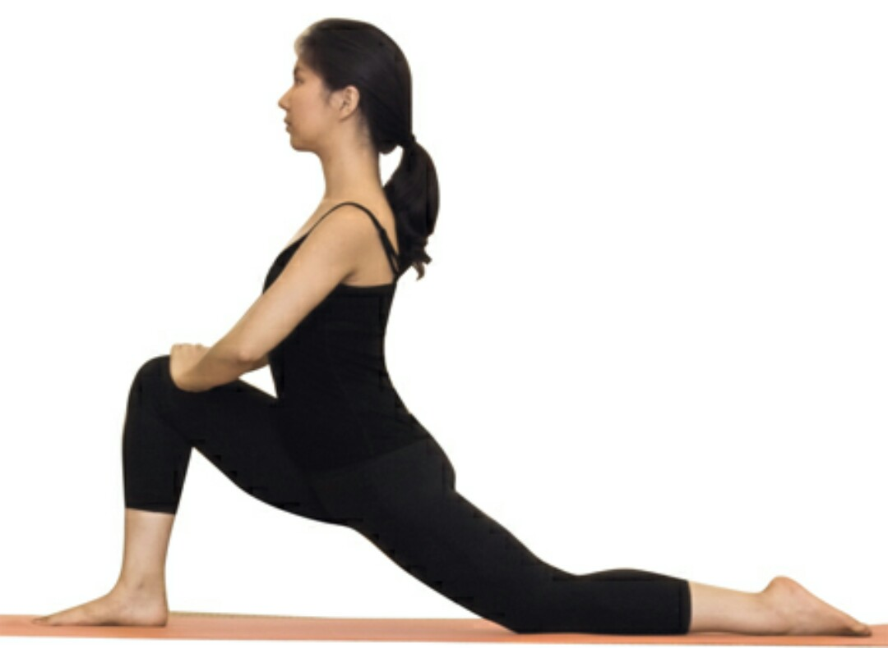
What if You Don’t Have
Exercise Equipment?
Engage in activities that get your heart rate up, such as running or jogging in place, jumping jacks, high knees, or skipping rope.
Perform exercises that use your body weight for resistance, such as push-ups, squats, lunges, planks, wall sits, and burpees.
Also, you could practice Yoga or Pilates routines that focus on bodyweight movements and stretching to improve flexibility, balance, and core strength.
Can any of you think of other alternatives?
Notes:
What if you don't have exercise equipment? Go through the content on the slide
Alternatives: Engage in activities that get your heart rate up, such as running or jogging in place, jumping jacks, high knees, or skipping rope. Perform exercises that use your body weight for resistance, such as push-ups, squats, lunges, planks, and burpees. Also, you could practice Yoga or Pilates routines that focus on bodyweight movements and stretching to improve flexibility, balance, and core strength.

Slide 9
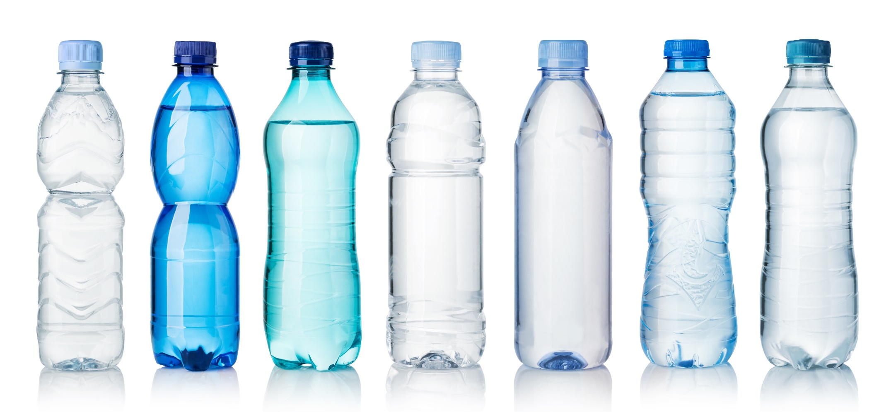
Fact or Fiction?
Water is the best way to hydrate before practice
or game day.
Notes:
Fact or Fiction? Read the statement. Answer: FACT!

Slide 10
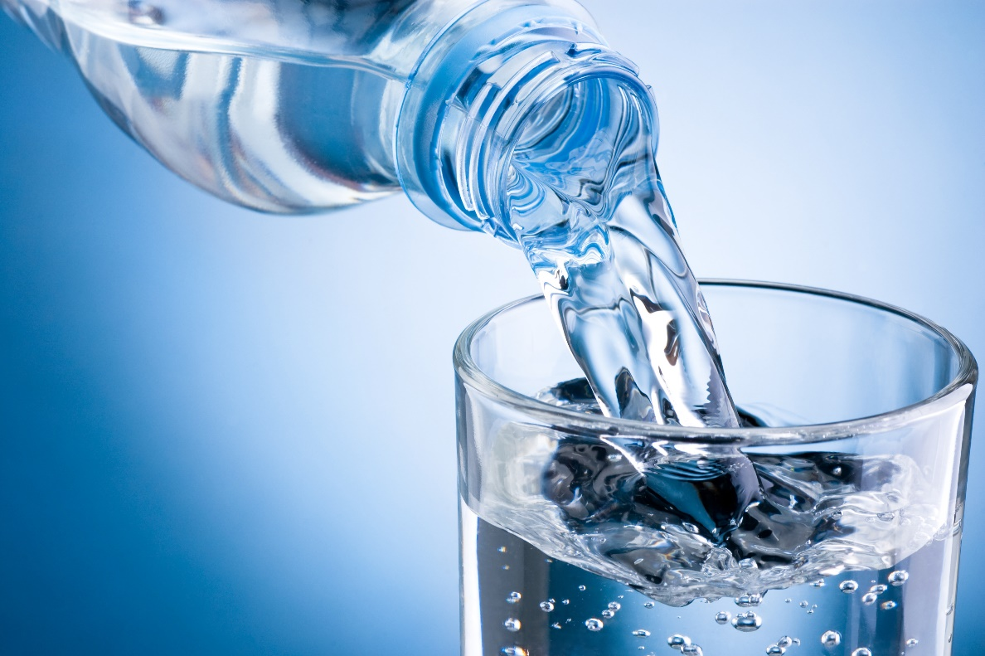
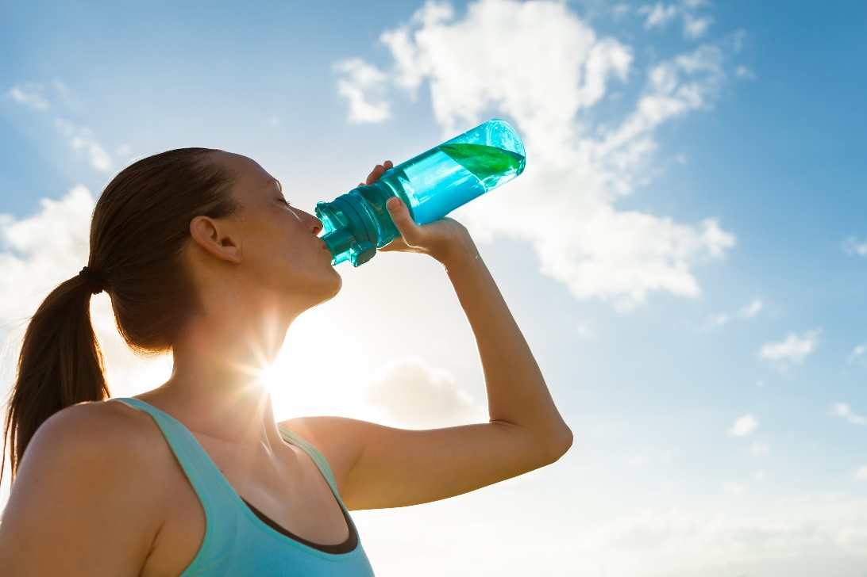
Basic Hydration Guidelines
Hydration – Should begin early in the day
  Drink 1 water bottle (17-20 oz) 2-3 hours before sporting event
  During Game: ½ of water bottle every 20 min (6-10 oz)
  Post-Game – Hydrate for sweat loss
60 minutes or more of activity – May need to drink a sports drink with carbohydrates and electrolytes
Notes:
Talk about the Hydration guidelines.

Slide 11

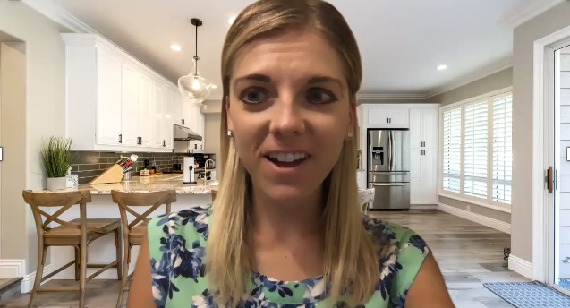

Meal Timing on Game Day
Need 2-3 hours to digest a larger meal before event
Small snack – can be eaten 30 minutes before event
  Granola bar
  Trail Mix
  Smoothie
  Fruit
Recovery – Balanced meal or protein and carbohydrate rich snack
  Sweet potato with grilled chicken and vegetables
  Glass of low-fat milk
  Peanut butter toast with whole grain bread
  Grilled Chicken Wrap
  Cottage Cheese & whole grain crackers
  Greek yogurt with fruit & granola
Sara – Nutrition College Student
https://health.utah.edu/nutrition-integrative-physiology
/community-outreach/utah-center-community-nutrition
/clinical-nutrition-resources
Notes:
It's important to focus on appropriate meal timing to optimize performance. Ideally, you should have a balanced meal containing carbohydrates, protein, and healthy fats about 2-3 hours before the game to provide sustained energy. It's also important to include a small snack 1-2 hours before the game to maintain blood sugar levels and ensure adequate hydration throughout the day. Can list off examples bulleted.
Play video: Sara-Game Day.

Slide 12
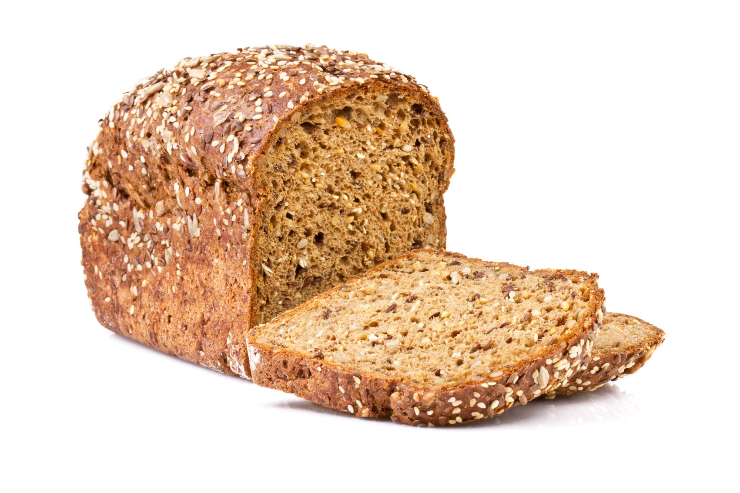
Sports Nutrition
Carbohydrates – Important for energy
  Whole grain crackers or bread
  Pasta
  Potatoes
Protein – Try to incorporate with every meal and snack
  Eggs or dairy products
  Deli meat
  Beans or tofu
  Chicken, turkey or fish
Notes:
Sports Nutrition: Proper sports nutrition aims to optimize energy levels, enhance recovery, promote muscle growth and repair, prevent injury, and support overall health & longevity. Carbohydrates and protein are essential components of sports nutrition due to their specific roles in fueling and supporting athletic performance.
Go through the examples of carbohydrates and protein.

Slide 13
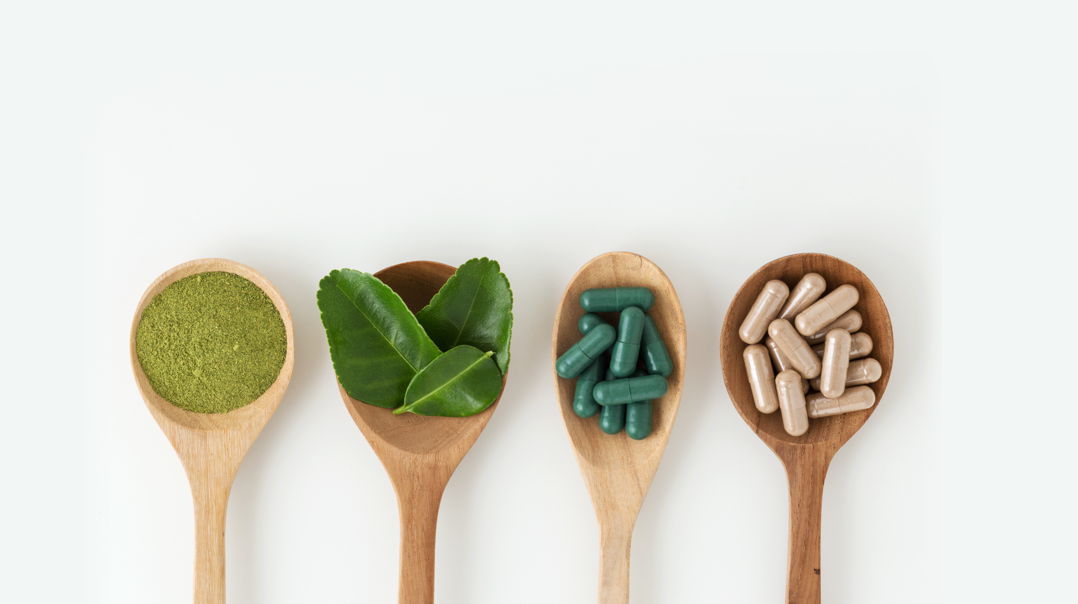
Fact or Fiction?
Nutritional Supplements are a better option
for nutrients than actual food.
Notes:
Fact or Fiction? Read the statement. Answer: FICTION!
Next slide play video to help explain why this is false

Slide 14
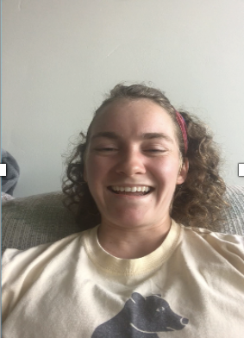
Nutritional Supplements
Hannah – Nutrition College Student
https://health.utah.edu/nutrition-integrative-physiology
/community-outreach/utah-center-community-nutrition
/clinical-nutrition-resources
Notes:
Play video: Hannah-Nutritional Supplements

Slide 15

Take Home Message
Regular physical activity promotes lifelong wellness and health
You do not have to go to the gym or play a sport to be physically active
Sports nutrition should be an extension of an overall healthy diet
It is better to eat whole foods rather than taking supplements
Notes:
Recap: Go over the Take home message

Slide 16

Discussion Questions
How many minutes of daily moderate to vigorous aerobic activity are recommended?
What are the health benefits of regular physical activity?
When may it be necessary to consume a sports drink?
Why is it better to consume actual food instead of a supplement?
Notes:
Go through each discussion question, answers below:
How many minutes of daily moderate to vigorous aerobic activity are recommended?
At least 60 minutes daily
How long before an athletic event should you consume a small snack?
30 minutes
What are the health benefits of regular physical activity?
Improved mood and self- esteem, helps prevent chronic disease, promotes bonding with family members and friends, builds strong bones and muscles, reduces risk of weight game and promotes life-long wellness and health.
When may it be necessary to consume a sports drink?
When a person has been exercising for more than 60 minutes
Why is it better to consume actual food instead of a supplement?
Supplements may have ingredients in them that are not listed or may have ingredients that are not good for you such as high levels of caffeine. Therefore, it is better to get your nutrients from actual food.

Slide 17
Choose 1 Activity
Create 1-2 Physical Activity Based SMART goals
Play sports? Write a meal plan for game day
Supplement Fact Sheet
Notes:
Choose 1 activity and hand out the worksheet that pairs with that activity.
Teacher chooses one activity for the class to do from the following list:
Create 1-2 Physical Activity Based SMART goals
Play sports? Write a meal plan for game day
Supplement Fact Sheet

Slide 18
References
Activity Conversion Chart (2020). Retrieved from https://earlham.edu/media/3049229/activityconversionchart.pdf
All the sources from the current Crush Diabetes curriculum
CDC (2020). CDC Healthy Schools. Physical Activity Facts. Retrieved from https://www.cdc.gov/healthyschools/physicalactivity/facts.htm#:~:text=Regular%20physical%20activity%20can%20help,Heart%20disease.
Kids eat right. 8 Gameday Nutrition Tips for Young Athletes. Retrieved from https://www.eatright.org/fitness/sports-and-performance/tips-for-athletes/gameday-nutrition-tips-for-young-athletes
KidsHealth (2015). Feeding Your Child Athlete. Retrieved from https://kidshealth.org/en/parents/feed-child-athlete.html
National Institutes of Health (2020). Dietary Supplement Fact Sheets. Retrieved from https://ods.od.nih.gov/factsheets/list-all/

