Slide 1
Nutrition Basics
Notes:
Introduce the topic: Nutrition Basics

Slide 2
Learning Objectives
Explore the basics of nutrition
Learn how to read a nutrition label
Discuss mindful eating
Master SMART goals
Notes:
Go over the learning objectives while passing out the Nutrition Basics Worksheet for students to complete as you go through the slide show.

Slide 3

Fact or Fiction?
Healthy eating habits for people with diabetes are the same healthy eating habits for people who do not have diabetes.
Notes:
Read the statement and ask the class if its fact or fiction? Answer: FACT!
Healthy eating habits for individuals with diabetes are essentially the same as those for individuals without diabetes. These habits include consuming a well-balanced diet rich in fruits, vegetables, whole grains, lean proteins, and healthy fats while being mindful of portion sizes and moderating the intake of sugary and processed foods.

Slide 4

What is a Healthy Breakfast?
Yogurt with fruit or nuts
Whole grain toast with eggs
Low-sugar cereal and milk
Banana Dog – peanut butter, banana and raisins in a whole grain bun
Breakfast Taco – scrambled eggs, shredded cheese, tortilla and salsa
Rice bowl topped with an egg
Sandwich – Grilled cheese, peanut butter and jelly, or another favorite
What is a healthy
breakfast?
Joana Alexa
St. Peternburg,USA
@joanaalex
+61 2435 2654
Jimmy – Nutrition College Student
https://health.utah.edu/nutrition-integrative-physiology
/community-outreach/utah-center-community-nutrition
/clinical-nutrition-resources
ipsum volutpat tincidunt dapibus at integer eleifend nulla dictum pellentesque lacus vitae tristique nullam malesuada nulla seds massa
Notes:
What does a healthy breakfast look like? Go through the examples with the class and then play the video: Jimmy-What is a Healthy breakfast?

Slide 5
Have You Heard of Mindful Eating?
Listening to signs of hunger and being full
Think about WHY you are eating
  Do you feel physically hungry?
  Are you stressed?
  Are you upset or sad?
  Are your friends eating?
Be mindful when eating by
  Avoiding TV and looking at your phone
  Eating at the dinner table instead of on the run
  Putting down your silverware in between bites
Notes:
Have you heard of mindful eating? Mindful eating is the practice of paying close attention to the present moment while eating, being aware of physical sensations, thoughts, and emotions related to food, and making conscious choices that promote overall well-being. It involves savoring each bite, eating slowly, and tuning into one's body's signals of hunger and fullness. Continue to go through the bulleted points of the slide content

Slide 6
Mindful Eating Activity
Sight – What color is the food? Does it look appetizing?
Smell – What does it smell like? Does it smell appealing?
Taste – How does it taste? Was it what you expected? Does it taste good or bad?
Texture – Is the texture of the food what you expected? Do you find it adds to the appeal of the food?
Notes:
Before going over the content, hand out food items for activity, then go over each point on the slide with the food item.

Slide 7
Fact or Fiction?
Fat is what your body uses for its main source of energy.
Notes:
Read statement and have class answer fact or fiction? Answer: Fiction, Carbohydrates are your bodies preferred and main source of fuel for energy. However, fat is a secondary fuel source.

Slide 8

6 Basic Nutrients
Macronutrients
  Carbohydrates – Body’s main source of energy
  Fats (lipids) – Used in the making of hormones. Can also be
  converted into energy
  Proteins – Builds and repairs tissues, muscles, cartilage and bones
Water
  Helps facilitate many essential biological processes within the body
  Approximately 60% of the human body is composed of water
  it is classified as a micronutrient as it is needed in smaller quantities compared to macronutrients
Micronutrients
  Vitamins – Body needs them for growth and development
  Minerals – Important for a healthy body
Notes:
Now we are going to talk about the 6 basic nutrients that are important for good health and why: Carbohydrates are important for good health as they serve as the body's main source of energy, providing fuel for daily activities and supporting brain function. Proteins are crucial for building and repairing tissues, producing enzymes and hormones, and supporting a healthy immune system. Fats play a crucial role in hormone production and regulation, and are essential for nutrient absorption, insulation, protecting organs, and also provide a secondary source of energy.
Water is essential for maintaining proper hydration levels in the body, supporting various physiological functions, and regulating body temperature. It plays a crucial role in digestion, nutrient absorption, circulation, and the removal of waste products, ensuring overall health and well-being.
Micronutrients are essential for the body as they play a vital role in various bodily functions and support overall health. These include vitamins and minerals that are necessary for maintaining a strong immune system, proper growth and development, optimal organ function, energy production, and promoting cellular processes and repair.

Slide 9

Protein
Food Sources:
  Lean meats like chicken and poultry
  Fish – 2-3 times a week
  Lentils
  Dairy
  Beans
  Red Meat – Limit to twice a week
  Quinoa
Notes:
Unlike carbohydrates and fats, your body cannot store protein, so you must consume it every day. Some examples of foods that are great sources of protein are: Go through list.

Slide 10


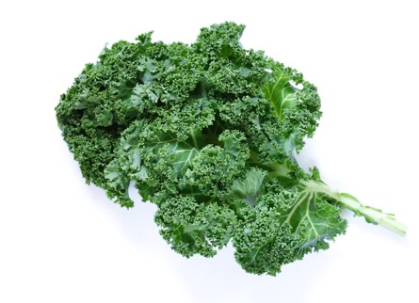
What is Nutrient Density?
Alex – Nutrition College Student
https://health.utah.edu/nutrition-integrative-physiology
/community-outreach/utah-center-community-nutrition
/clinical-nutrition-resources
Notes:
What is Nutrient Density?
Play video: Alex- Nutrient Density

Slide 11

Fruits and Vegetables
Eat a rainbow of colors
Frozen and canned are just as nutritious
Try to incorporate at least 1 with every snack and meal
Try a new fruit or vegetable each month
  Dragon Fruit
  Jicama
  Mango
  Jackfruit
  Snap peas
  Sweet corn
  Plums
Notes:
Let's talk about some nutrient dense foods; Fruits & Vegetables are important for good health because they are rich in essential vitamins, minerals, and dietary fiber.
They provide valuable antioxidants that support the immune system, promote healthy digestion, and help reduce the risk of chronic diseases when included as part of a balanced diet. Eating a rainbow of colors through fruits and vegetables is important because it ensures a diverse range of beneficial nutrients, antioxidants, and phytochemicals.
Continue to read through bullet points.

Slide 12

Why Whole Grains?
Contain more nutrients such as fiber, vitamins and minerals
Reduces risk of chronic disease
Helps to maintain a healthy weight
Try getting at least 3 servings daily
Examples of whole grain products
  Brown rice
  Plain popcorn
  Oatmeal
  Whole grain pastas and breads
Notes:
What about Whole Grains....why do we want to eat whole Grains?
Read through content

Slide 13

Fad Diets
Paleo
Gluten Free
Keto
Whole30
Other Eating Patterns
Vegetarian​
  Absence of meat and meat related products ​(including fish)​
Vegan​
  Absence of meat ​
  Absence of dairy, eggs and animal products​
Important to get protein in the diet from other food sources!​
  Quinoa​, lentils , beans, tofu, & dairy products (for Lacto-vegetarians)
Miley – Nutrition College Student
https://health.utah.edu/nutrition-integrative-physiology
/community-outreach/utah-center-community-nutrition
/clinical-nutrition-resources
Notes:
Let's now talk about Fad Diets, some common fad diets are...
Play video: Miley
What about other eating patterns? Click for info to pop up.
Go through each one and talk about the importance of getting enough protein and how from other food sources

Slide 14
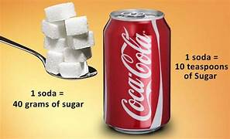
Added Sugars
Limit intake of added sugars
Try to save your favorite treats for SPECIAL OCCASIONS
  Cookies
  Cake
  Candy
  Ice Cream
Drink mostly WATER!
Limit your intake of:
  Soda
  Sweet teas
  Sports and energy drinks
  Fruit juice
Eat a fruit for dessert when you are craving a sweet treat
Notes:
Added sugars refer to sugars that are added to food and beverages during processing or preparation. Consuming excessive amounts of added sugars can contribute to various health issues, such as weight gain, tooth decay, and an increased risk of chronic diseases like obesity, diabetes, and heart disease. It is important to limit the intake of added sugars and opt for healthier alternatives.
Go through content
Click for picture to fly in and talk about the Scoop on sugar; Did you know that in a can of soda, there is about 40g of sugar which is about 10 teaspoons of sugar. This reminds us to be mindful of how much sugar we consume. It's important to remember that too much sugar can affect our health.
Consuming excessive amounts of sugar on a regular basis can lead to various health issues, such as weight gain, tooth decay, and an increased risk of developing conditions like diabetes and heart disease. Being mindful of our sugar intake and making healthier beverage choices can contribute to our overall well-being and help us maintain a balanced and nutritious diet.

Slide 15

Fact or Fiction?
On a nutrition facts label, ingredients are listed in descending order by weight and quantity (the amount of the ingredient that is in the particular food).
Notes:
Fact or Fiction? Read statement. Answer: FACT!

Slide 16
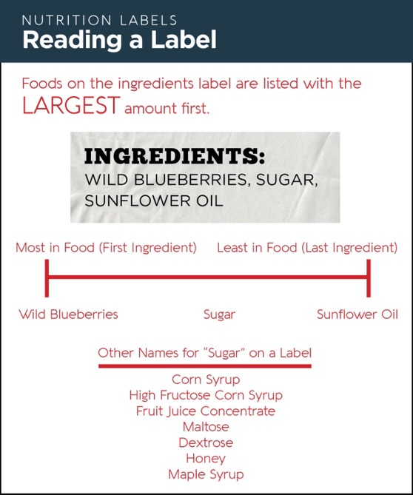
Ingredients List
What is the first ingredient?
This product contains the most of this ingredient
The next ingredient listed is sugar
That means the second highest ingredient is sugar
Try choosing foods where sugar is not in the top three ingredients
Notes:
Go over Reading a label example and content that is bullet pointed

Slide 17
Serving
Information
Calories
Quick Guide to percent Daily Value (%DV)
5% or less is low
20% or more is high
Nutrients
Notes:
Servings per container and serving size information usually appear in large, bold font. The serving size is not a recommendation of how much to eat, but the nutrition information listed on the Nutrition Facts label is usually based on one serving of the food. One package of food may contain more than one serving.
Calories are now in larger and bolder font to make the information easier to find and use. It is based off the serving size information, not the whole container. However, some containers may also have information displayed per package. 2,000 calories a day is used as a guide for general nutrition advice but your calorie needs may be higher or lower depending on your age, sex, height, weight, and physical activity level. The percent Daily Value shows how much a nutrient in a serving of food contributes to a total daily diet. As a general guide, 5% DV or less of a nutrient per serving is considered low and 20% DV or more of a nutrient per serving is considered high. The footnote at the bottom of the label explains it as well. The nutrient section on a food label gives us important information about the good stuff, like vitamins and minerals, that are in the food. It also tells us about things we should try to limit, such as sugar, which can affect our teeth and overall health, and fiber, which helps us feel full and keeps our digestion running smoothly. So, it's good to pay attention to this section to make healthy choices!

Slide 18


How about Fast Food?
Danielle – Nutrition College Student
https://health.utah.edu/nutrition-integrative-physiology
/community-outreach/utah-center-community-nutrition
/clinical-nutrition-resources
Notes:
What about Fast Food?
Play Video: Danielle-Fast food

Slide 19

Creating Smart Goals
Specific
Measurable
Achievable
Relevant
Time-Bound
Example: I will eat 1 serving of vegetables
with lunch 5 days a week for 1 month.
Notes:
SMART goals are like maps that help us know exactly where we want to go. They make sure our goals are clear, can be measured, and we can achieve them on time. It's like having a plan to make sure we do our best and succeed. Use the example.

Slide 20

Brainstorm Activity
Discuss ideas or campaigns you could start to improve dietary choices and increase physical activity within your school or community.
Adding vending machines with fruits and healthy snacks
Changing your school lunch menus to include more fresh fruits and vegetables
Removing processed and sugary foods from school lunch menus
Asking local gyms to provide reduced/free rates for teens
Take a hike or go to the park with friends or family
Notes:
Go over Activity Grassroots Initiative slide content
Any other ideas? Walking challenge, healthy snack day at school to share

Slide 21

Take Home Message
Kids who eat a healthy breakfast tend to be more focused at school, have more energy, and have a better chance of maintaining a healthy weight
You can purchase 3-4 apples for the cost of 1 soda
Try choosing a rainbow of colors when eating fruits and vegetables
Whole grains contain more nutrients such as fiber, vitamins and minerals
Try saving your favorite sweets for special occasions
A balanced diet that is sustainable is better than a “fad” diet
Notes:
Recap: Go over the take home message

Slide 22

Discussion Questions
What food or drink do you have the most often? Do you think it is a healthy food or drink? What are the ingredients? Does it contain added sugar?
When you are reading a nutrition label, what are the ingredients that you should be paying extra attention to that may not be as nutritious?
Why are whole grains an important addition to your diet?
Why do you think it is important to make a SMART goal achievable?
SMART Goals Activity
Notes:
Go through discussion questions with class
Answers:
What food or drink do you have the most often? Do you think it is a healthy food or drink? What are the ingredients? Does it contain added sugar?
No right or wrong answer. Will depend on the drink that the student has most often.
When you are reading a nutrition label, what are the ingredients that you should be paying extra attention to that may not be as nutritious?
Sugar content can be masked by ingredients such as high fructose corn syrup, sucrose, and fructose.
Why are whole grains an important addition to your diet?
They contain more fiber, vitamins and minerals. They also decrease the risk of developing a chronic disease and weight gain.
Why do you think it is important to make a SMART goal achievable?
If it is not achievable you will be much more likely to not be able to complete the goal. This can lead to frustration and a sense of failure. On the other hand, setting achievable goals will make it much more likely that you can attain it. Once it becomes a habit, you can always add to it.
Last Activity: Hand out Smart Goals Worksheet
Give students 5 - 10 minutes to complete

Slide 23
References
All sources from the current Crush Diabetes curriculum.
Houghton Mifflin Harcourt (2020). 7 Nutrition Activities for Elementary and Middle School Students. Retrieved from https://www.hmhco.com/blog/nutrition-activities-elementary-middle-school-students
Kids Health (2020). Breakfast. Retrieved from https://kidshealth.org/en/kids/breakfast.html
Kids Health (2020). Why Drinking Water is the Way to Go. Retrieved from https://kidshealth.org/en/kids/water.html
NIH (2020). Vitamins and Minerals. Retrieved from https://www.nccih.nih.gov/health/vitamins-and-minerals#:~:text=Vitamins%20and%20Minerals-,Vitamins%20and%20Minerals,biotin%2C%20and%20folate%2Ffolic%20acid
Oldways Whole Grains Council (2020). Retrieved from https://wholegrainscouncil.org/
U.S. Food and Drug Administration (2020). How to Understand and Use the Nutritional Facts Label. Retrieved from https://www.fda.gov/food/new-nutrition-facts-label/how-understand-and-use-nutrition-facts-label
All sources from the current Crush Diabetes curriculum
USDA (2016). Kids Food Critic Activity. Retrieved from https://www.fns.usda.gov/tn/kids-food-critic-activity
U.S. National Library of Medicine (2020). Minerals. Retrieved from https://medlineplus.gov/minerals.html#:~:text=Minerals%20are%20important%20for%20your,for%20making%20enzymes%20and%20hormones.

