Slide 1
Diabetes 101
Notes:
Introduce the Topic: Diabetes 101

Slide 2
Learning Objectives
Understand the:
  Etiology
  Pathophysiology
  Prevalence
  of Type 1 and Type 2 diabetes.
Notes:
Go over the Learning Objectives for the day
Hand out Diabetes 101 Worksheet for students to fill out during the presentation.

Slide 3

Fact or Fiction?
Type 1 diabetes is caused by eating
too much sugar.
Notes:
Fact or Fiction? Read the Statement. Answer: FICTION!
Type 1 diabetes is primarily caused by an autoimmune response, where the body's own defense system attacks and damages the special cells in the pancreas that make insulin. Basically, the immune system gets mixed up and mistakenly harms the cells that are responsible for managing sugar levels in our body. Some people may have genes that make them more likely to have type 1 diabetes, and certain things in the environment can also trigger it.

Slide 4

What is Diabetes?
https://health.utah.edu/nutrition-integrative-physiology/community-outreach/utah-center-community-nutrition/clinical-nutrition-resources
Notes:
We will now watch a short clip that dives in a little deeper about what diabetes is. Click on the link & play the video: What is Diabetes?

Slide 5

How Does My Body Use
Fuel for Energy?
You consume food which is fuel for your body
Your body digests the food and turns it into glucose
Glucose gets into your bloodstream
Your pancreas provides your body with insulin
Insulin helps to get the glucose from your bloodstream into your cells
Your cells are then able to use the glucose for energy
Notes:
How Does Your Body Use Fuel for Energy? Go through the bulleted points top to bottom.

Slide 6



Insulin Facts
Hormone made by your pancreas
Life-saving and life sustaining
Helps your body use glucose for energy
Type 1 Diabetes:
  Pancreas is unable to produce insulin
https://health.utah.edu/nutrition-integrative-physiology/community-outreach/utah-center-community-nutrition/clinical-nutrition-resources
Type 2 Diabetes:
  Pancreas is not able to produce enough insulin
  Body is resistant to using insulin
Notes:
Play Insulin Video
Insulin Facts: Go through facts about insulin and then talk about the two different types of diabetes.

Slide 7

Simple presentation template
Type 1 Diabetes
https://health.utah.edu/nutrition-integrative-physiology/community-outreach/utah-center-community-nutrition/clinical-nutrition-resources
Notes:
Play Type 1 Diabetes video

Slide 8
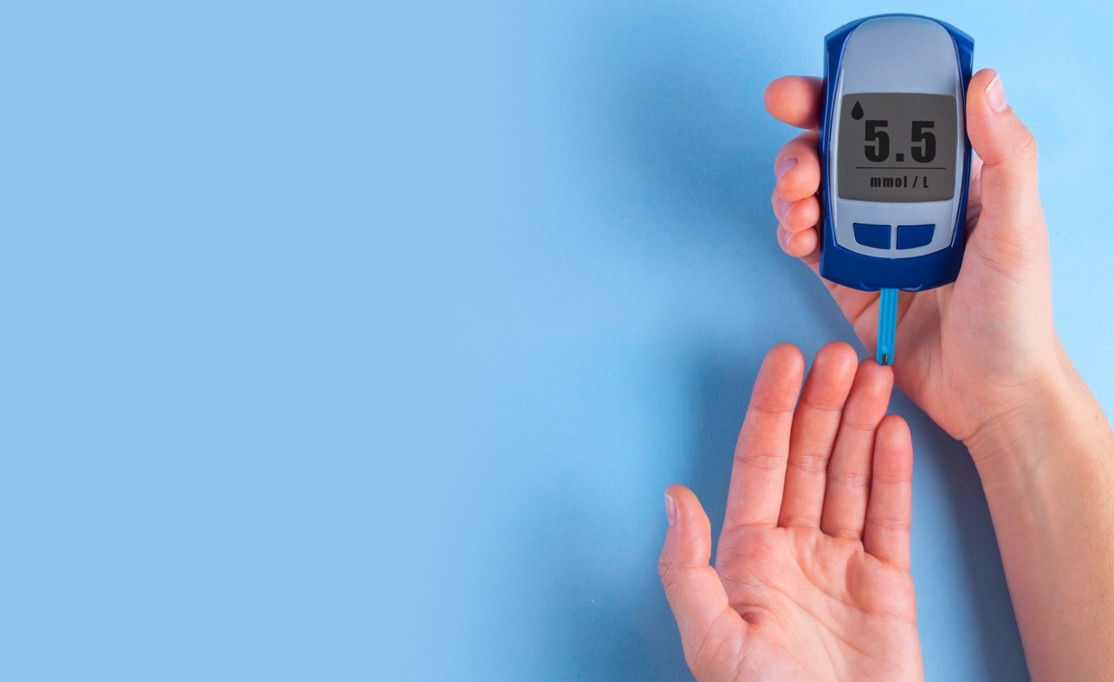
Type 1 Diabetes
About 5 -10% of people with diabetes have Type 1
Autoimmune disorder – Body attacks itself and destroys cells in pancreas which produce insulin
Pancreas is unable to produce insulin and cannot use glucose
Must inject themselves with insulin through shots or insulin pump
This is a blood glucose monitor used to measure blood sugar levels
Warning Signs
Warning signs and symptoms – Usually occurs suddenly
  Excessive thirst
  Frequent urination
  Increased appetite
  Rapid weight loss
  Unexplained fatigue
  High amounts of sugar in blood/urine
    Sweet odor may be present in urine or breath or body sweat
Notes:
Go through content on the slide about Type 1 Diabetes

Slide 9
Simple presentation template
Type 2 Diabetes
https://health.utah.edu/nutrition-integrative-physiology/community-outreach/utah-center-community-nutrition/clinical-nutrition-resources
Notes:
Now, let's watch a clip about Type 2 Diabetes. Play video: Type 2 Diabetes

Slide 10
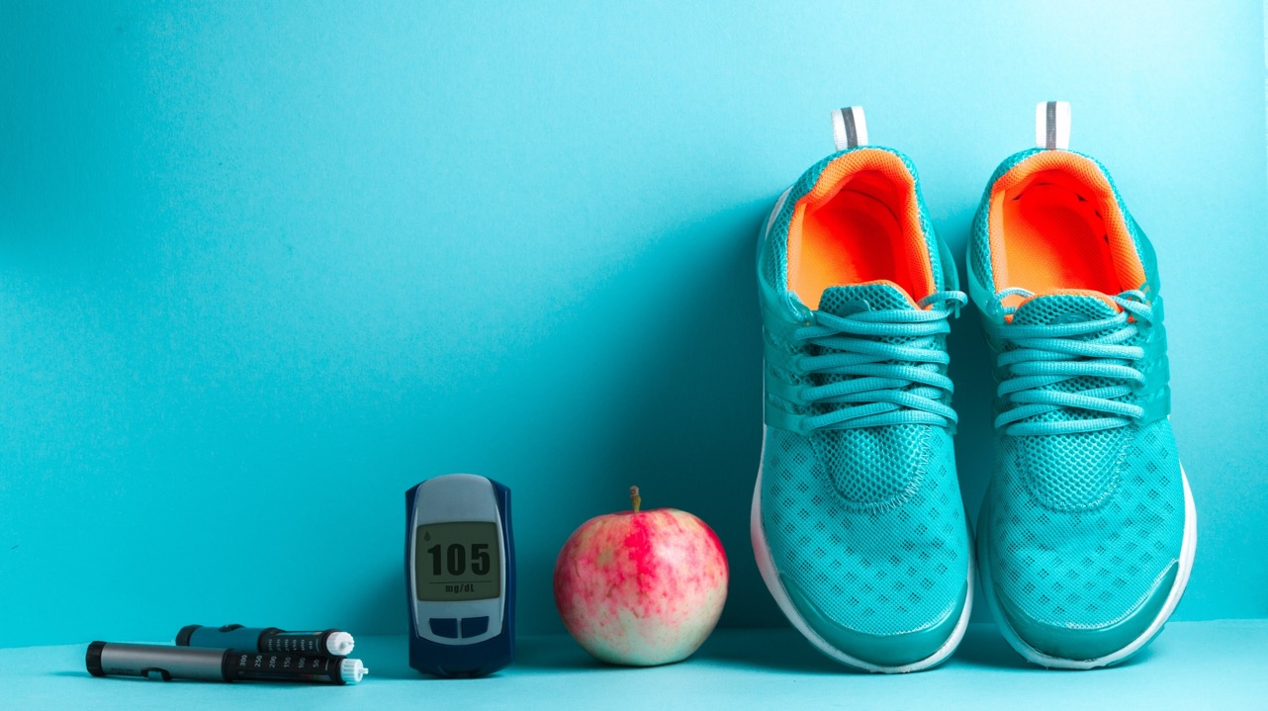
Type 2 Diabetes
About 90-95% of people with diabetes have Type 2
  Was primarily diagnosed in older adults
  Increasingly common in children and teenagers
Influenced heavily by lifestyle
  Can make insulin but cannot make enough
  Pancreas is not able to make enough insulin and/or the body doesn’t use it properly
Can be controlled through nutritious diet and regular physical activity
Notes:
Go through content on the slide about Type 2 Diabetes

Slide 11

Type 2 Diabetes Warning Signs
Warning Signs and Symptoms – Can occur slowly over time
  Blurred vision
  Tingling or numbness in legs, feet or fingers
  Recurring skin, gum or urinary tract infections
  Drowsiness
  Slow healing of cuts and bruises
  Any symptoms that occur with Type 1 diabetes
Notes:
Talk about the Warning sign and symptoms of Type 2 Diabetes

Slide 12
Why are Type 2 Diabetes Numbers Rising?
Teenagers and children are spending more time being inactive
  Video games
  Television
  Computers
Increased consumption of processed junk foods
  Easy to access
  Can be lower cost
Added sugars
  Soda
  Candy
  Cookies
  Ice Cream
Notes:
Does anyone know why Type 2 Diabetes numbers are rising?
Teenagers and children are increasingly engaging in sedentary behaviors, such as playing video games, watching television, and using computers. Moreover, their consumption of processed junk foods has also risen. These foods are easily accessible, often affordable, and loaded with added sugars. Examples of such sugary treats include soda, candy, cookies, and ice cream.

Slide 13

Consequences of Diabetes
Having high and uncontrolled blood sugar can lead to many serious health issues
  Blindness
  Damage to circulation in hands and feet eventually leading to amputations
  Kidney failure
  Heart disease
Eating a healthy diet and regular physical activity
  Helps with blood sugar levels in both Type 1 and
  Type 2
  People with Type 1 still need to take insulin
Notes:
Talk about the consequences of diabetes; consequences of having high, uncontrolled blood sugars; go through bullet points.
Talk about what eating a healthy diet with regular physical activity does: Maintaining a regular and balanced eating pattern with healthy meals is crucial for stabilizing blood sugar levels. It is recommended to have at least three meals per day. Engaging in regular physical activity has a positive impact on blood sugar levels. When we are active, our muscles use glucose for energy, which helps to lower blood sugar levels. Physical activity also improves insulin sensitivity, allowing our bodies to use insulin more effectively. It is important to find activities that we enjoy and make them a part of our daily routine to help maintain healthy blood sugar levels.

Slide 14


Managing Blood Glucose
People with both Type 1 and Type 2 diabetes have to monitor their blood glucose
How do they do this?
  Give themselves finger sticks especially before & after meal times
    For Type 1 – Lets them know how much insulin they need
    For Type 2 – Lets them know what foods and activities affect their blood sugar
Low Blood Sugar
  Dizziness, weakness or fainting
High Blood Sugar
  Extreme thirst, blurry vision,
  weakness or dizziness
Notes:
Talk about the management of Type 1 and Type 2 and the differences in symptoms of a low and high blood sugar.

Slide 15

What is an A1C Test?
Blood test
Reported as a percentage
Tests what your blood sugar has been over the last 2-3 months
Is used to diagnose Type 1, Type 2 and pre-diabetes
Levels
  Under 5.7% – Normal
  5.7%-6.4% – Pre-diabetes
  6.5% and above – Diabetes
What is a healthy
breakfast?
Joana Alexa
St. Peternburg,USA
@joanaalex
+61 2435 2654
ipsum volutpat tincidunt dapibus at integer eleifend nulla dictum pellentesque lacus vitae tristique nullam malesuada nulla seds massa
Notes:
What is an A1C test? Read through bullet points

Slide 16

Take Home Message
Diabetes occurs when your blood sugar is higher than normal and affects how your body changes food into energy
Type 1 diabetes – Autoimmune disorder where the body attacks itself and destroys cells in pancreas which produce insulin
Type 2 diabetes – When the body either cannot make enough insulin or the body doesn’t use it properly
Diabetes numbers are on the rise because of -
  Increased consumption of junk food
  Added sugars
  Inactivity
Eating a healthy diet and regular physical activity helps with blood sugar levels in both Type 1 and Type 2 diabetes
Notes:
Recap: Go over take home message

Slide 17

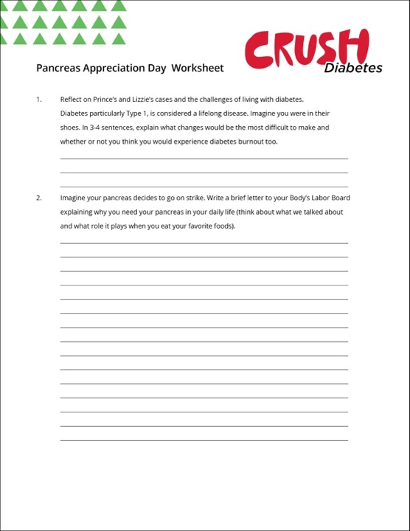
Discussion Questions
Why is Type 2 diabetes referred to as the “lifestyle” disease? What are the most common steps taken to try and control Type 2?
How does Type 1 diabetes differ from Type 2?
The number of cases of Type 2 diabetes is rising quickly in teenagers and even in children. What do you think is contributing to these increasing numbers in our culture?
What role does insulin play when it comes to Type 1 diabetes?
What is an A1C test?
In-Class Activity​
Pancreas Appreciation Day Worksheet
Notes:
Go through each discussion question. Answers below.
Answers:
Why is Type 2 referred to as the “lifestyle” disease? What are the most common steps taken to control Type 2?
Type 2 diabetes is known as the lifestyle disease because the key factors that cause Type 2 diabetes are a poor diet and lack of exercise. If a person eats too much sugar or other unhealthy foods, it becomes increasingly more difficult for the body to do its job which is to produce enough insulin and to use the insulin that is produced correctly. The most common steps taken to control Type 2 are regular physical activity and a healthy diet.
How does Type 1 diabetes differ from Type 2?
Type 1 diabetes is an autoimmune disorder. For unknown reasons, the immune system of a person with Type 1 diabetes mistakenly attacks and destroys the Beta cells in their pancreas that produce insulin. Type 2 diabetes is a metabolic disorder that can sometimes be controlled with a healthy diet and regular exercise. Being overweight, eating foods high in sugar and inactivity can significantly increase your risk of developing Type 2 diabetes.
The number of cases of Type 2 diabetes is rising quickly in teenagers and even in children. What do you think is contributing to these increasing numbers in our culture?
Our increasingly sedentary lifestyles are contributing to the rise in diabetes. There is more time inside playing video games or watching television instead of playing sports and other physical activities. Also, the types of food that we eat, and portion sizes have changed over the past 50 years. Much of the food we now eat is highly processed and fast food is at our fingertips. This means that there are extra additives and sugar in many packaged foods. The combination of these two elements is leading to the increase of Type 2 diabetes.
What role does insulin play when it comes to Type 1 diabetes?
Type 1 diabetes is an autoimmune disease where the pancreas is unable to produce insulin. Therefore, those with Type 1 must take insulin shots so that their bodies can use food as energy.
What is an A1C test?
An A1C test is a blood test which tests what your blood sugar has been over the last 2-3 months. It is often used to diagnose Type 1, Type 2, and pre-diabetes.
Hand out Pancreas Appreciation Day Worksheet

Slide 18
References
All the sources from the current Crush Diabetes curriculum.
American Diabetes Association (n.d.). Understanding A1C. Retrieved from https://www.diabetes.org/a1c
Diabetes State Burden Toolkit. (2020). Retrieved from https://nccd.cdc.gov/Toolkit/DiabetesBurden/YLL
Kidshealth (2020). Type 1 Diabetes: What is it? Retrieved from https://kidshealth.org/en/kids/type1.html

