Slide 1
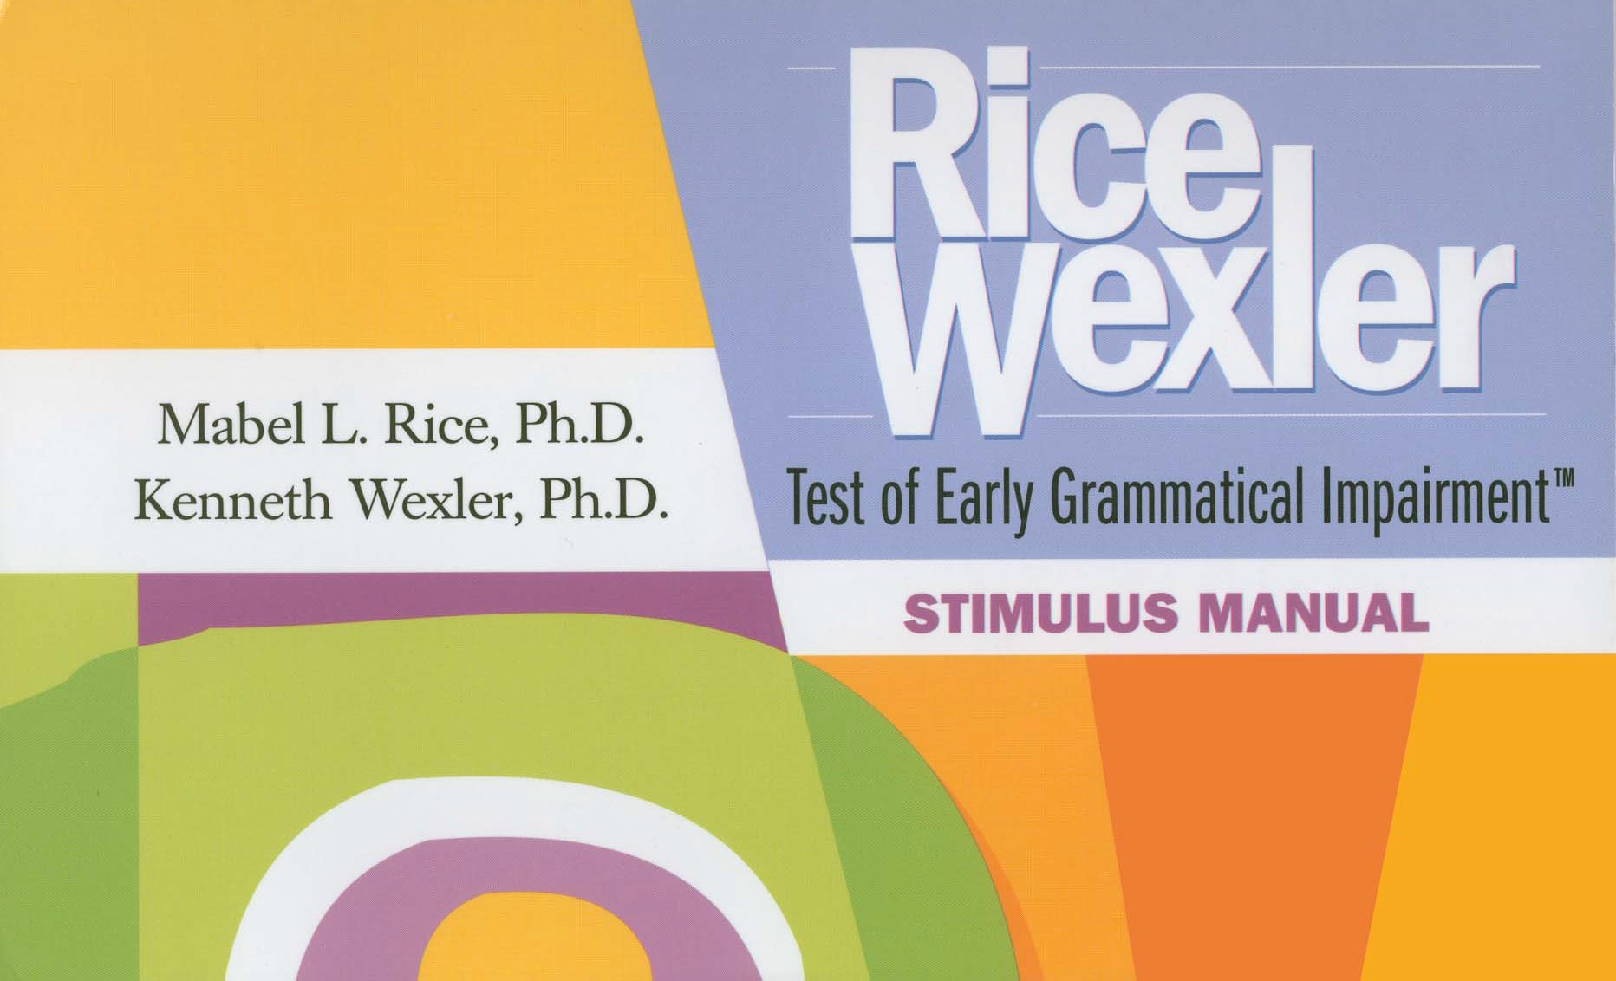
Phonological Probe

Slide 2
Phonological Probe
Notes:
Say, "I am going to show you some pictures and ask you to name some things." Show the child each picture and ask "What is this?" or present the prompt below the item to elicit the response. If the child does not know the target word, model the word and ask the child to repeat it.

Slide 3
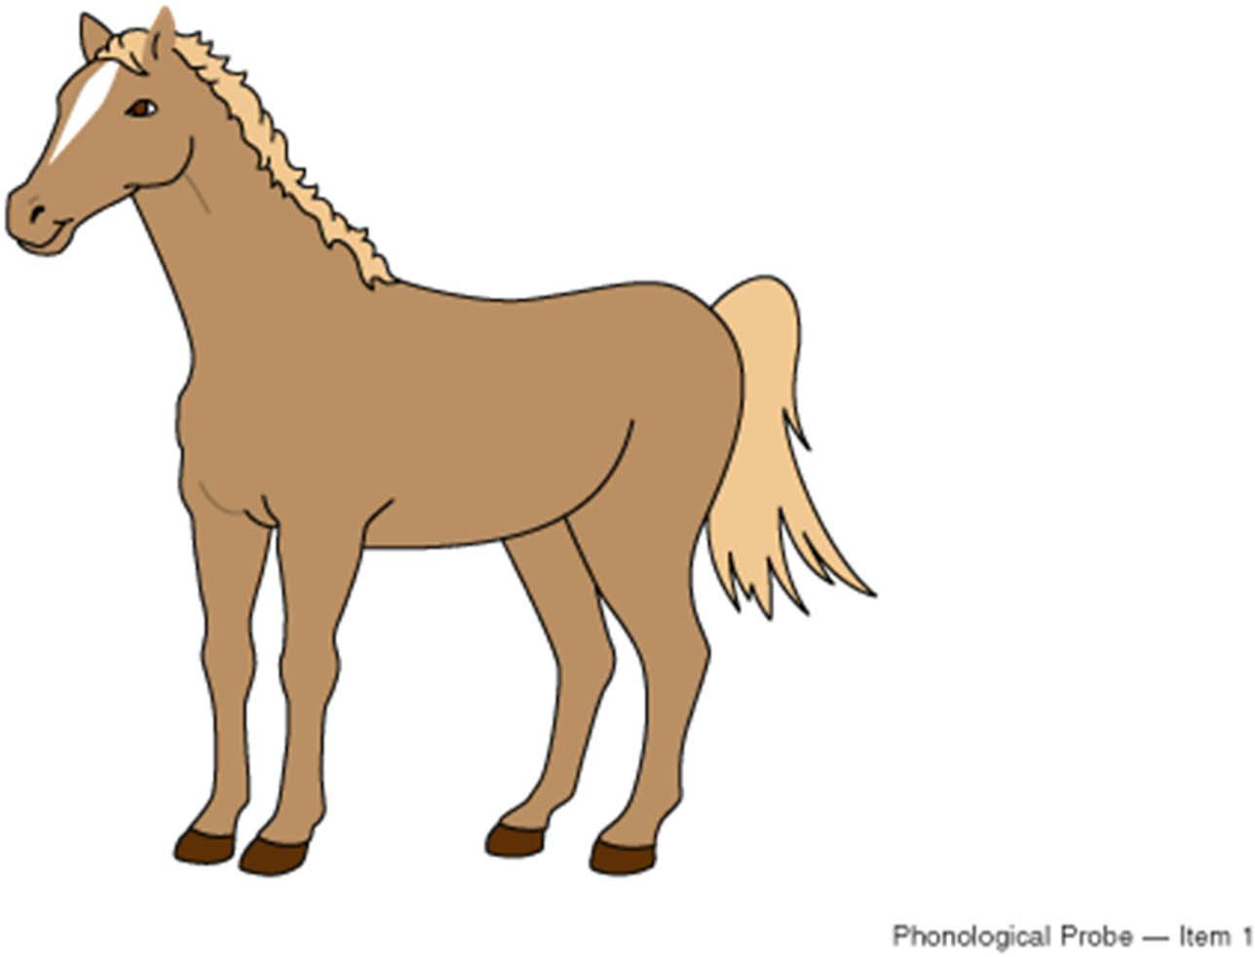
Phonological Probe – Item 1
Notes:
horse

Slide 4
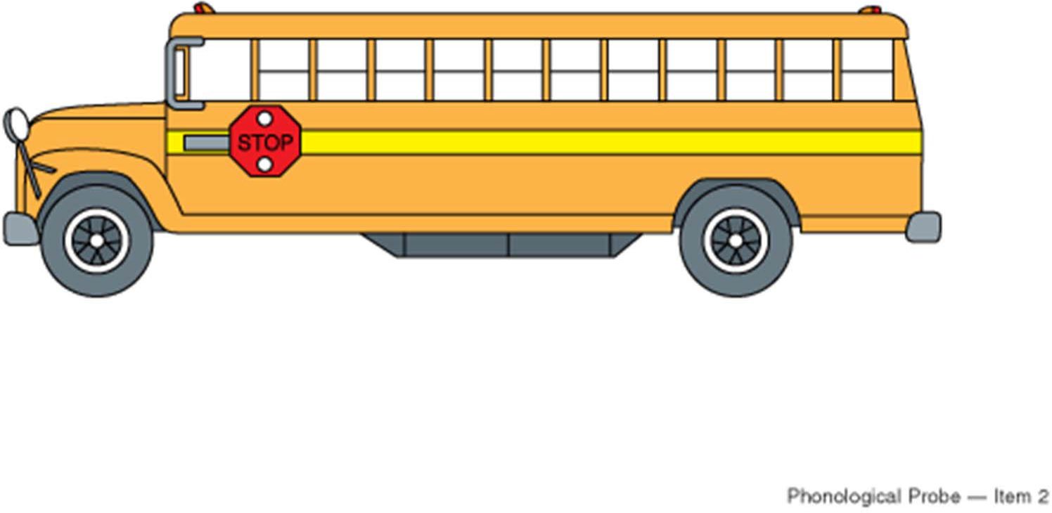
Phonological Probe – Item 2
Notes:
bus

Slide 5
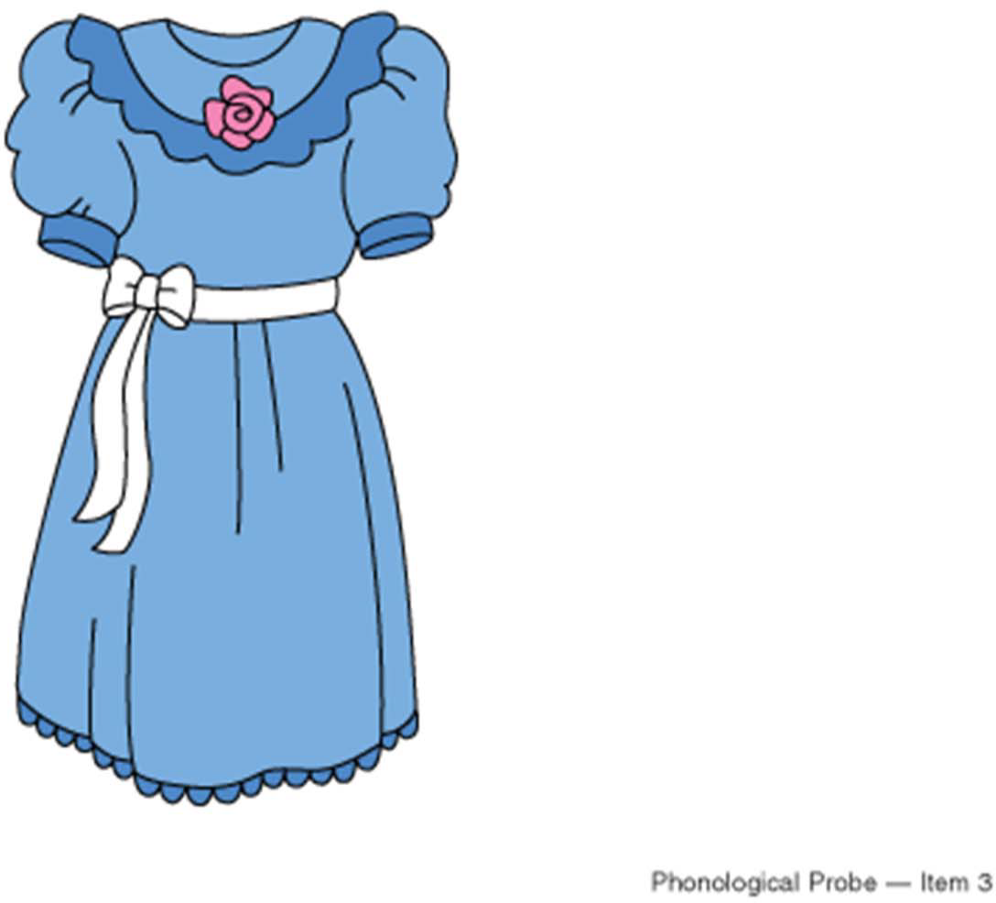
Phonological Probe – Item 3
Notes:
dress

Slide 6
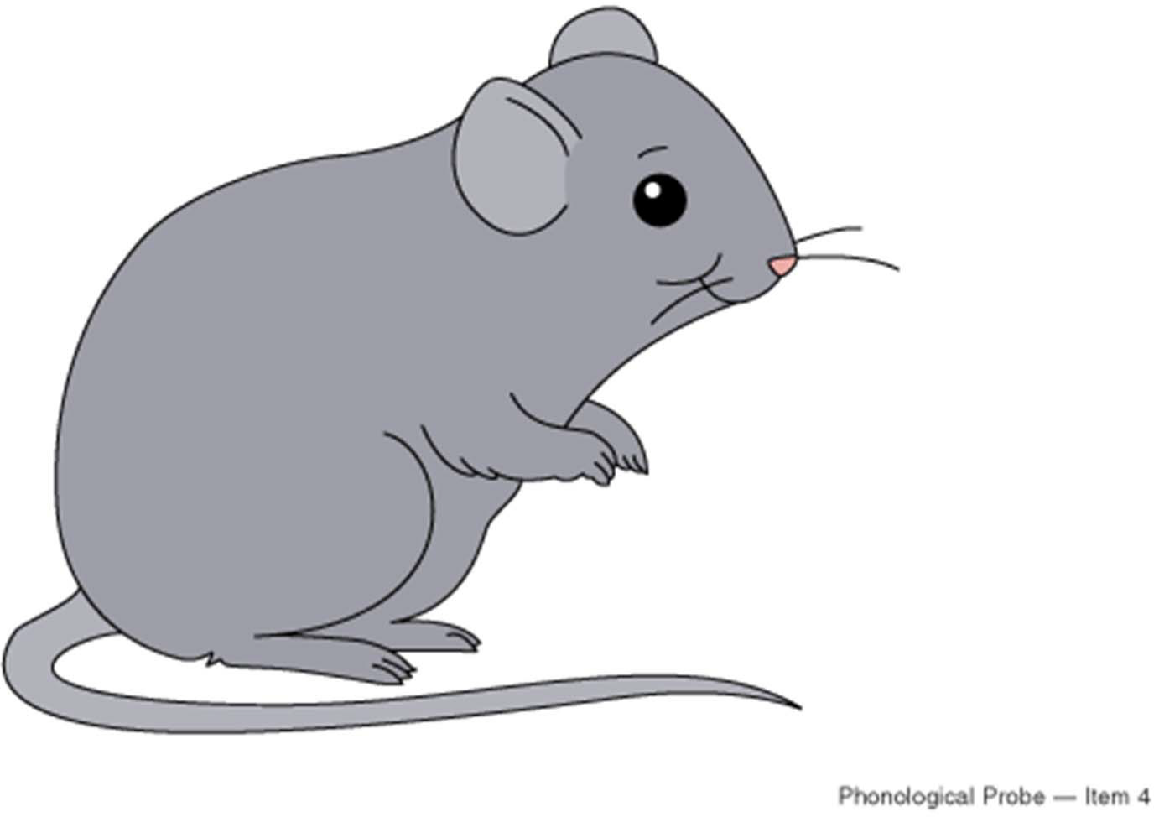
Phonological Probe – Item 4
Notes:
mouse

Slide 7
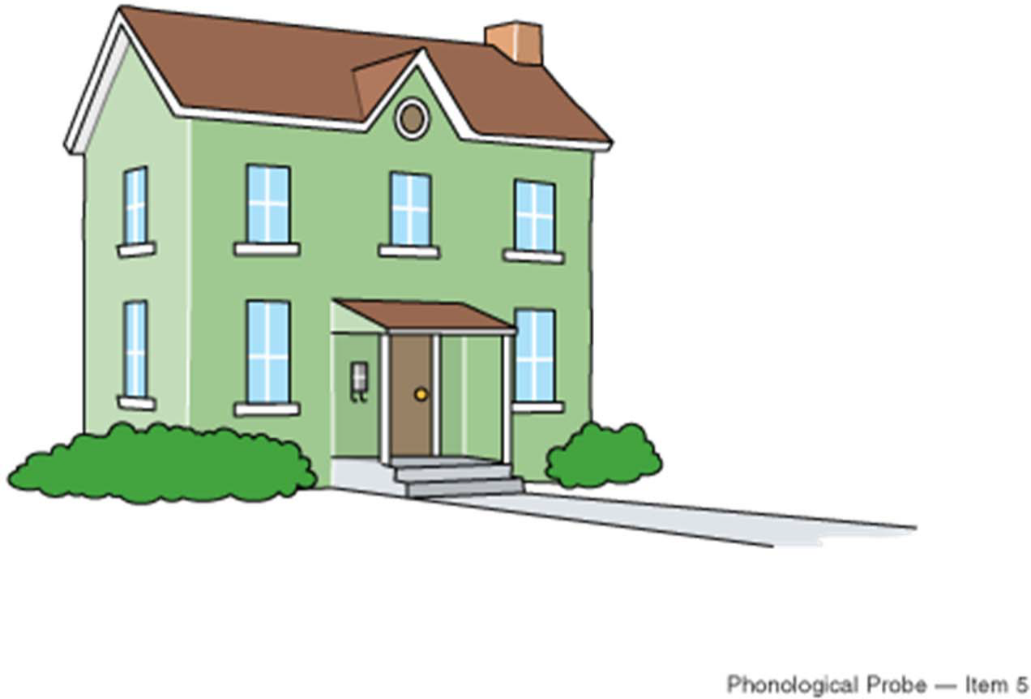
Phonological Probe – Item 5
Notes:
house

Slide 8
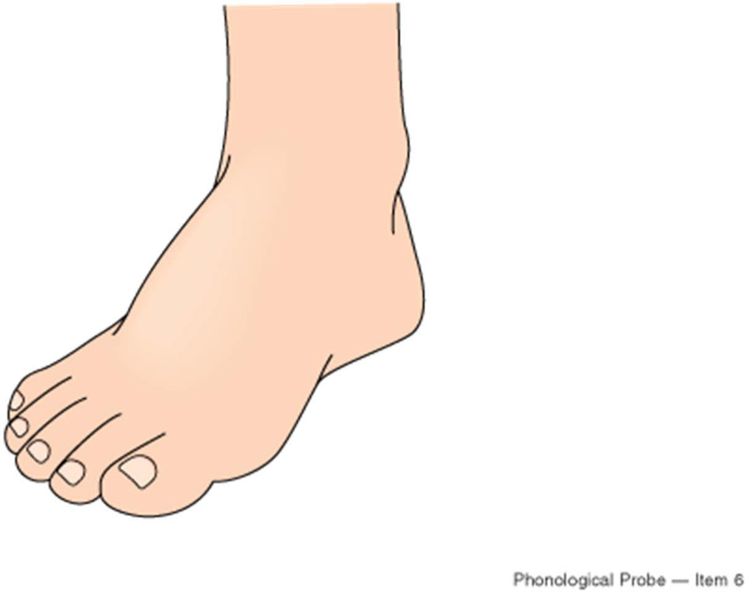
Phonological Probe – Item 6
Notes:
foot

Slide 9
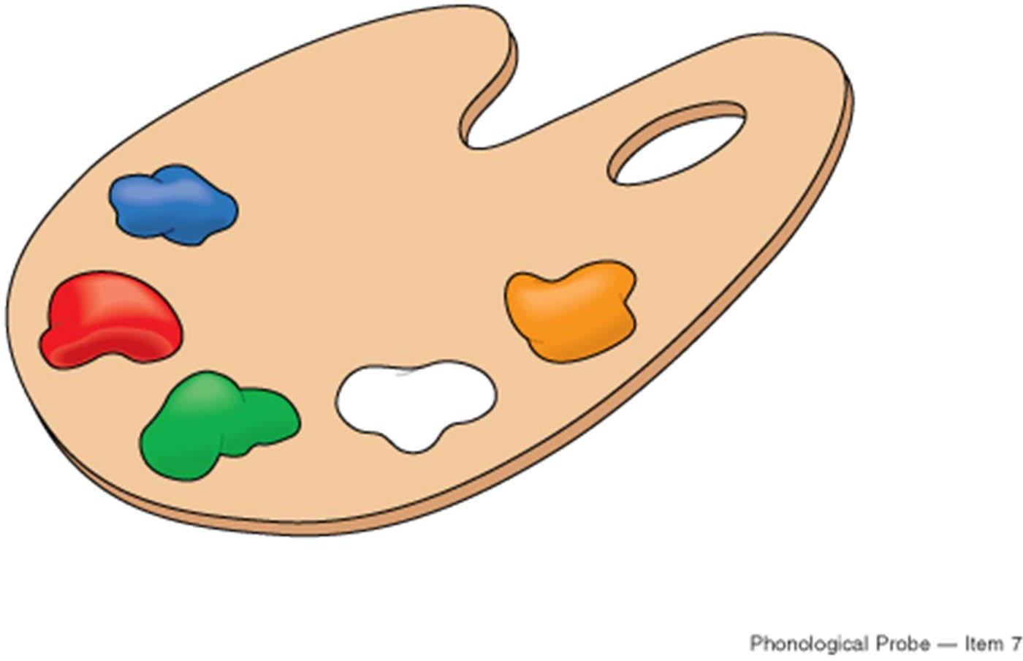
Phonological Probe – Item 7
Notes:
White (point to white and ask what color is this?)

Slide 10
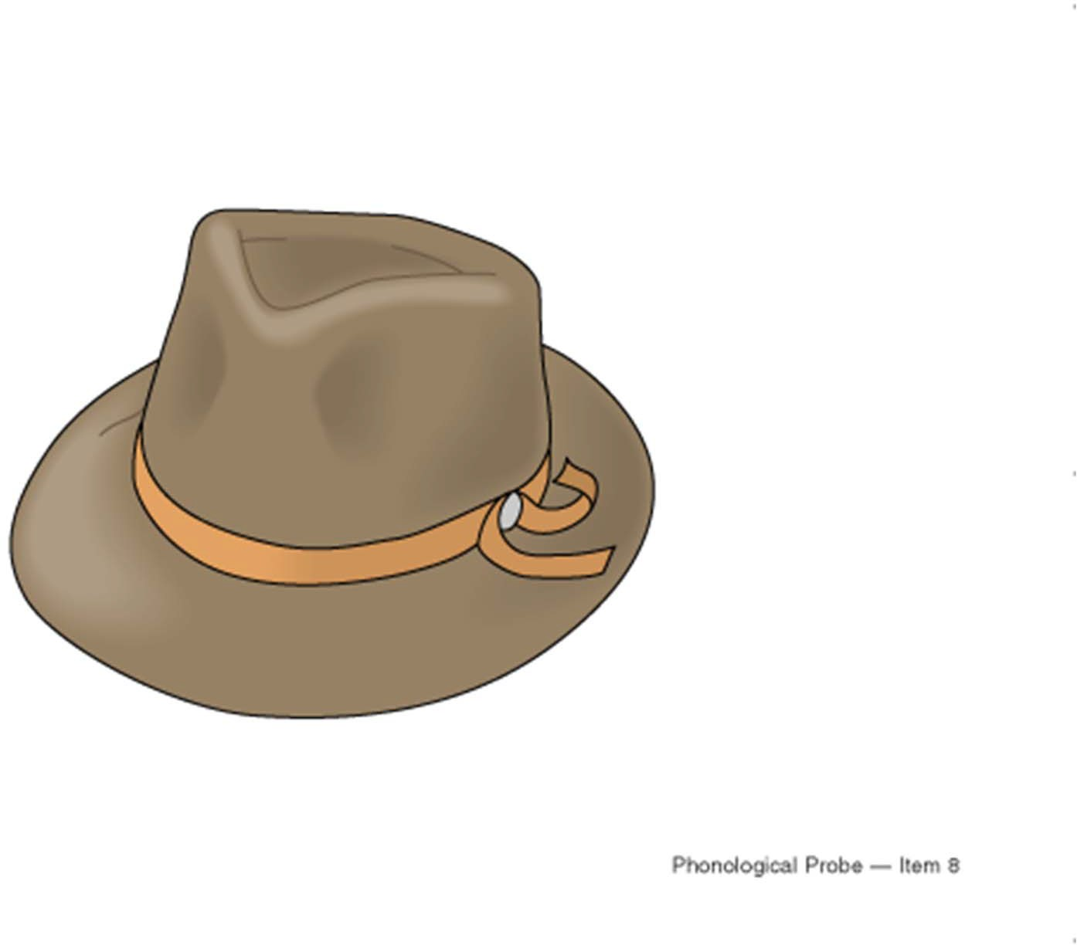
Phonological Probe – Item 8
Notes:
hat

Slide 11
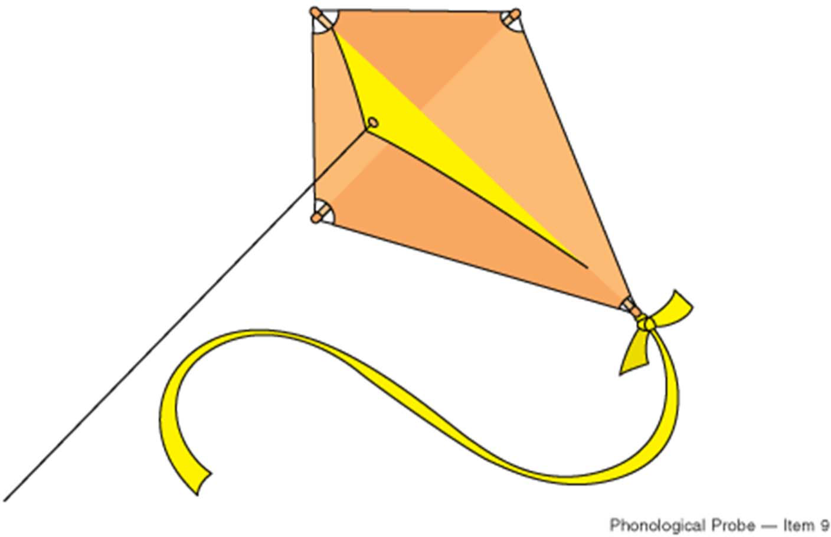
Phonological Probe – Item 9
Notes:
kite

Slide 12
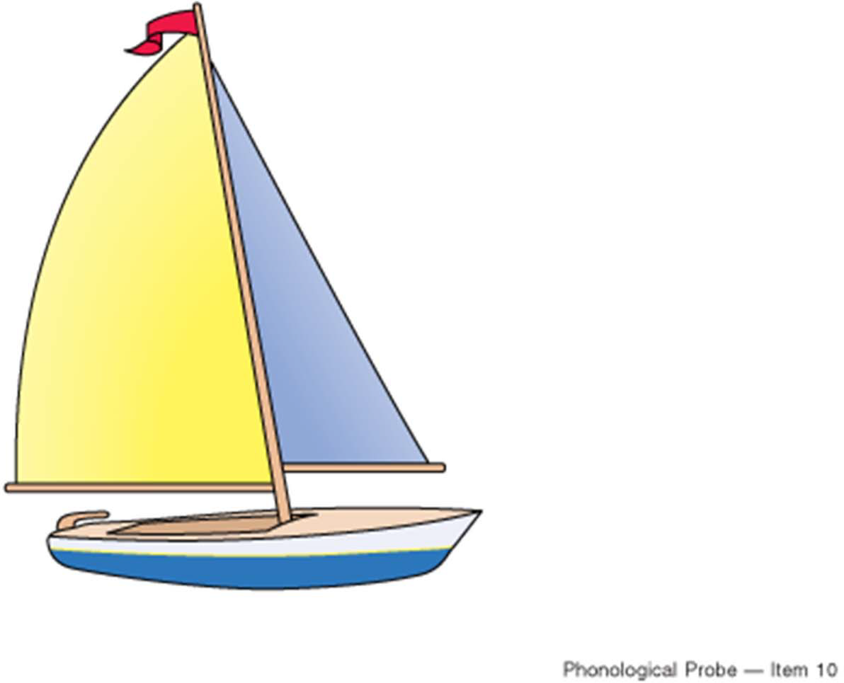
Phonological Probe – Item 10
Notes:
boat

Slide 13
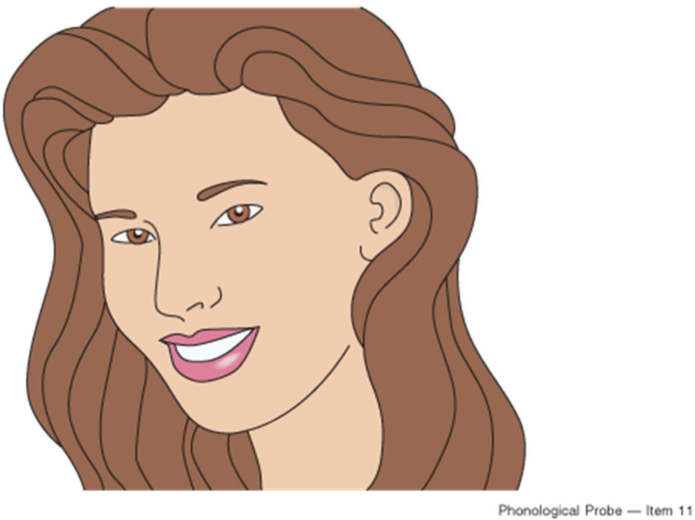
Phonological Probe – Item 11
Notes:
Nose (point to nose and ask “what is this?”)

Slide 14
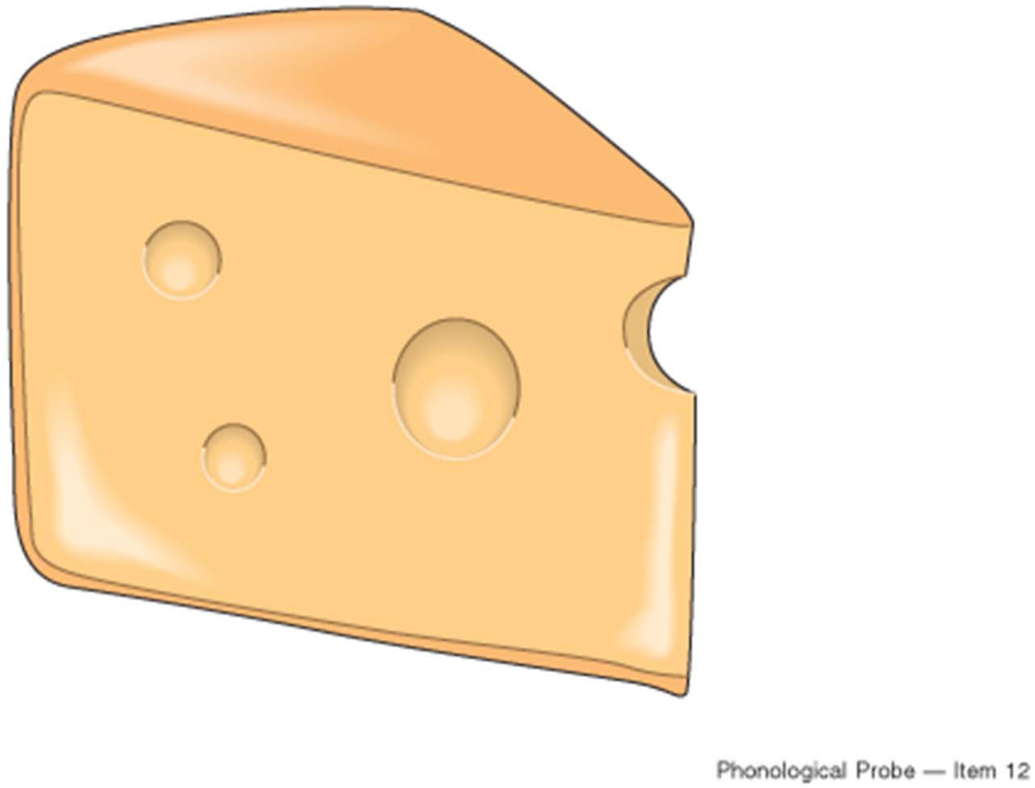
Phonological Probe – Item 12
Notes:
cheese

Slide 15
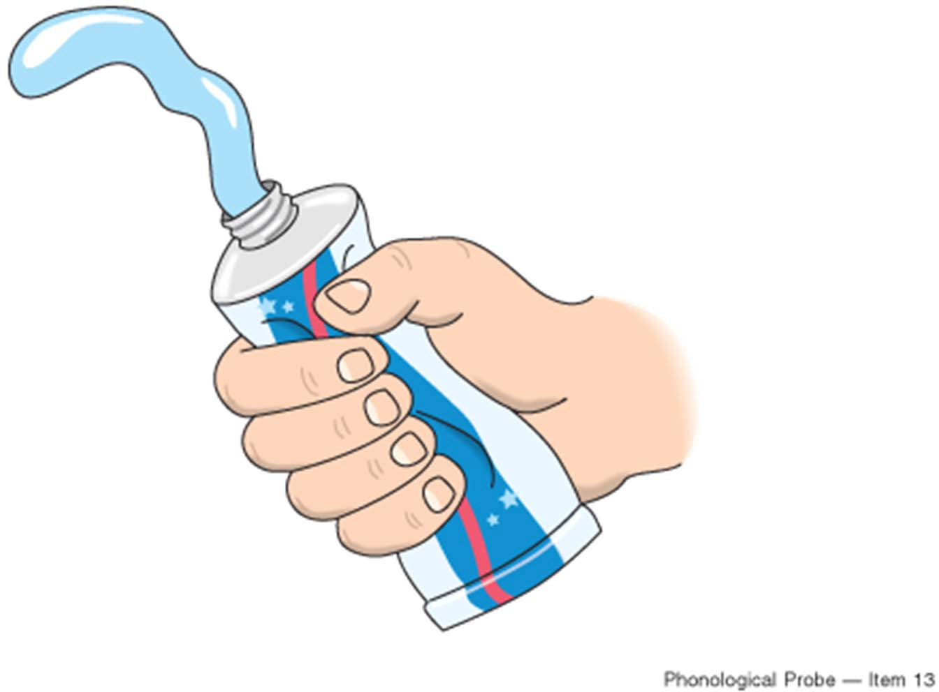
Phonological Probe – Item 13
Notes:
Say: “Here is some toothpaste. What do you do to the tube to make the toothpaste come out?”

Slide 16
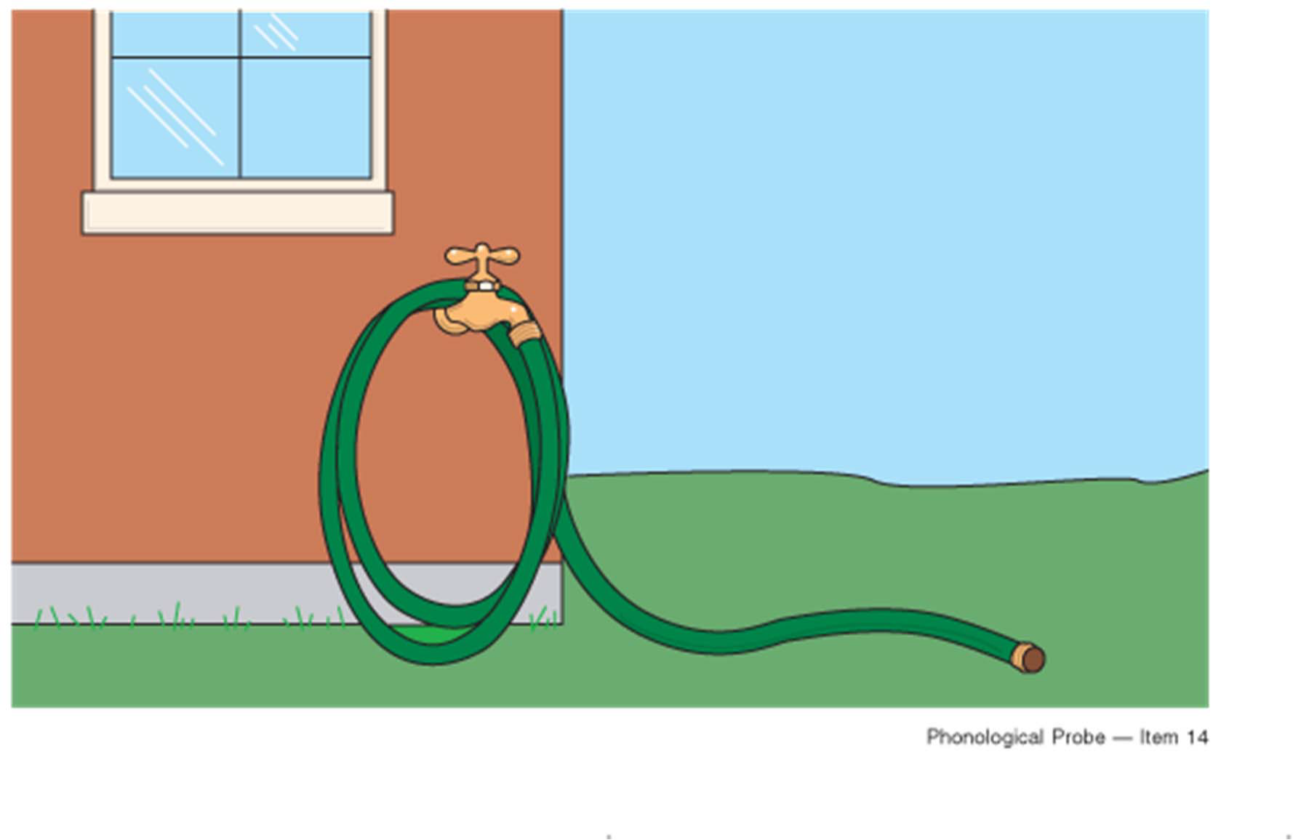
Phonological Probe – Item 14
Notes:
hose

Slide 17
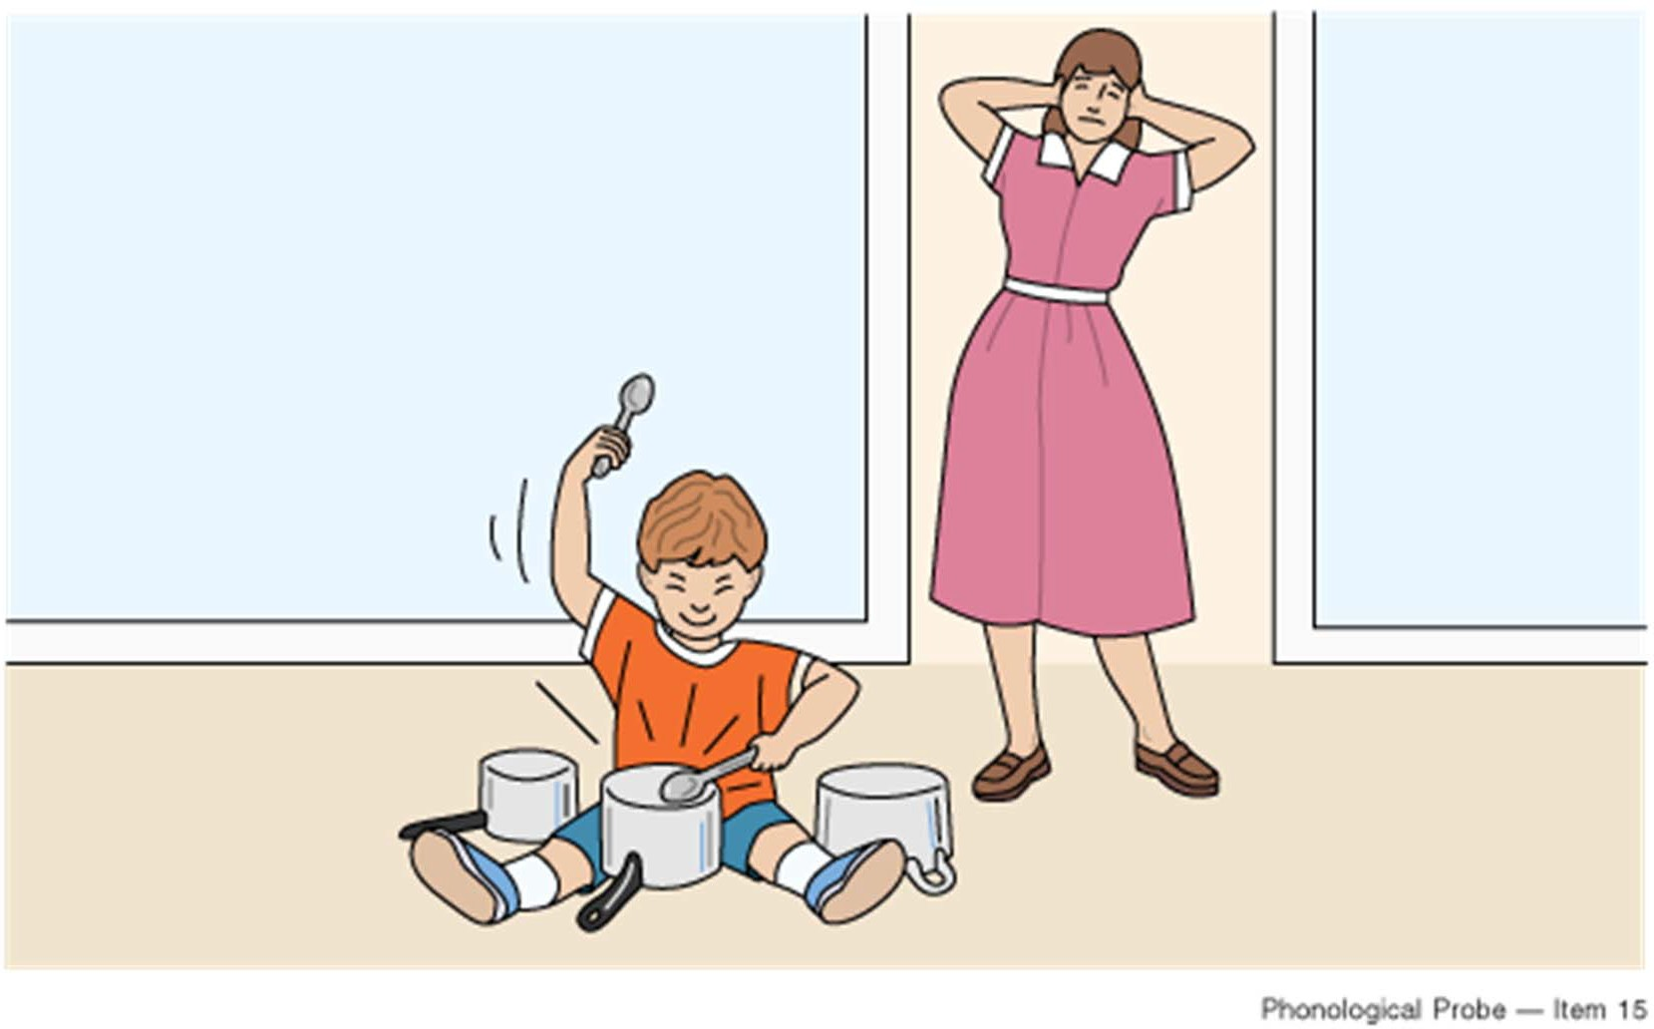
Phonological Probe – Item 15
Notes:
Say “The boy is banging on the pots. He is making too much ____.” (noise)

Slide 18
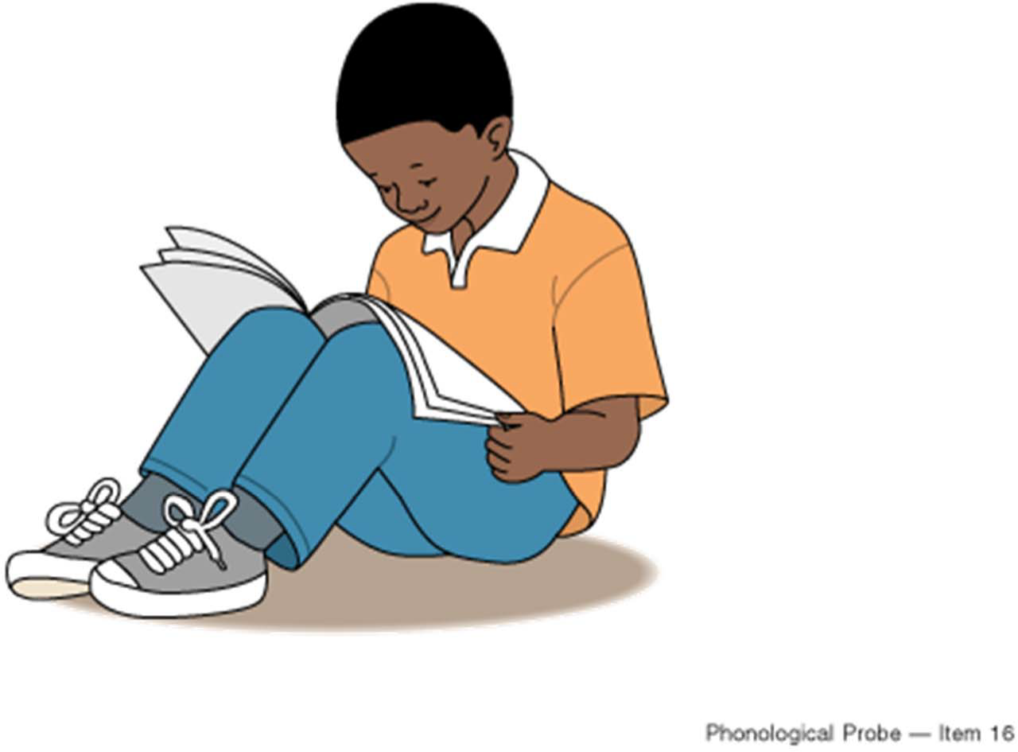
Phonological Probe – Item 16
Notes:
“This boy is going to _____.” (read)

Slide 19
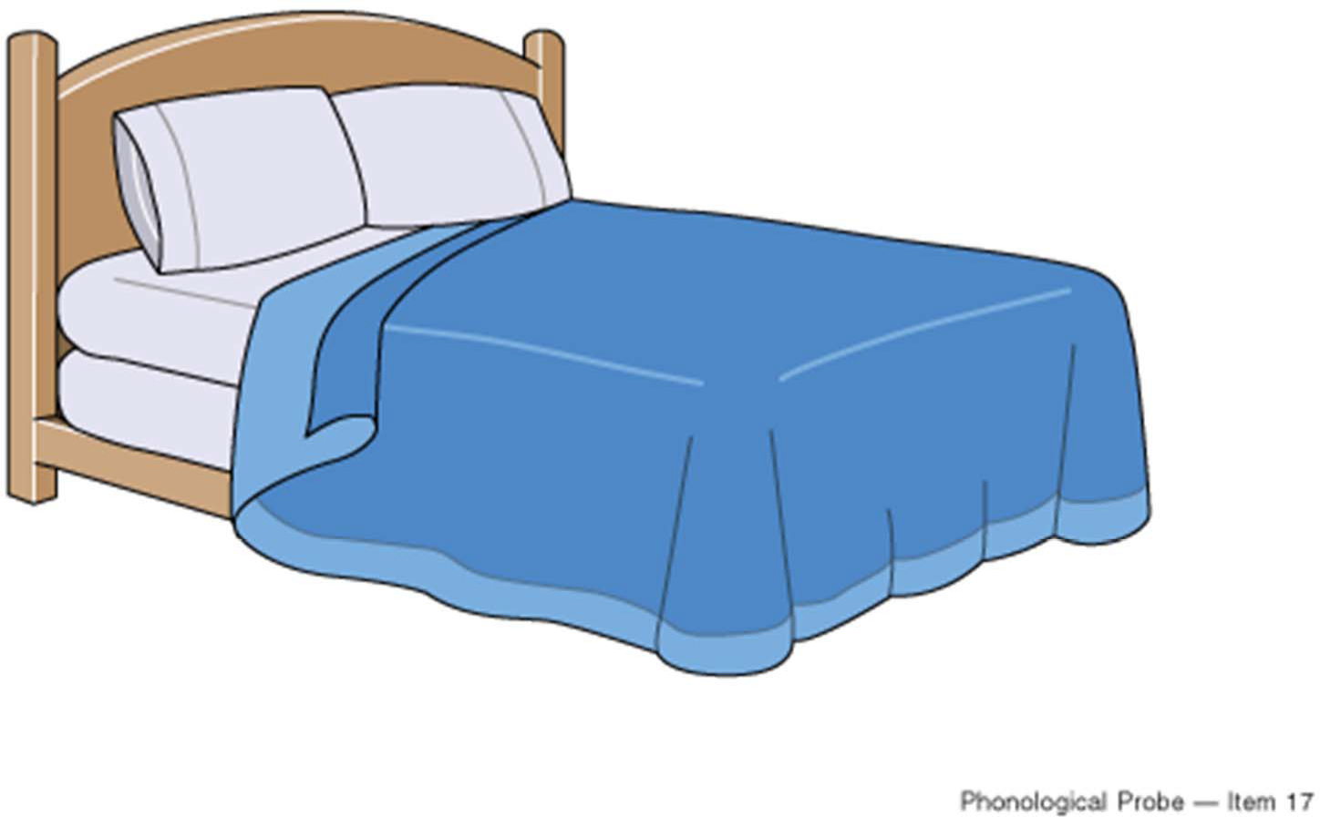
Phonological Probe – Item 17
Notes:
bed

Slide 20
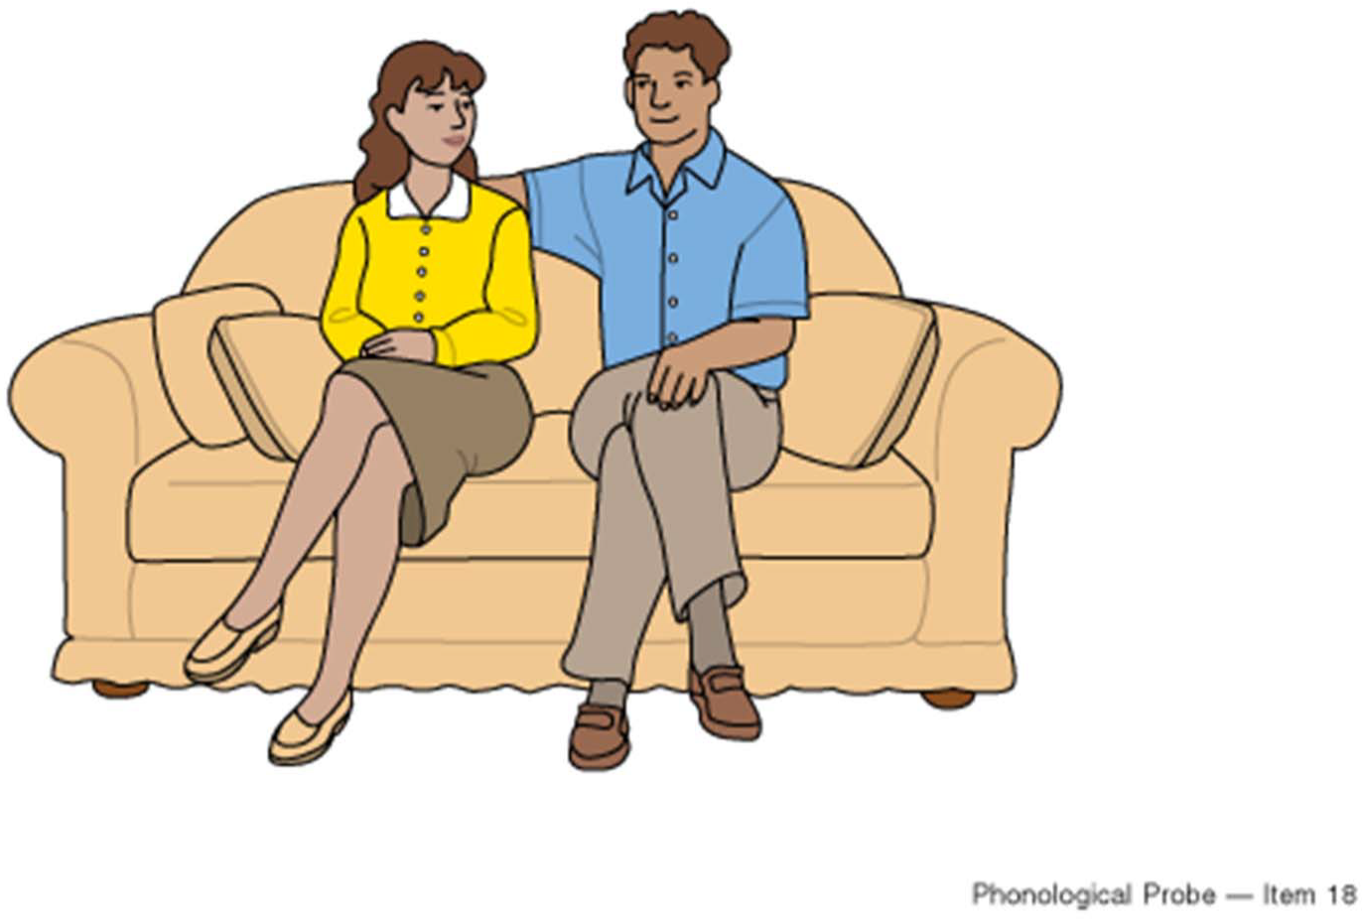
Phonological Probe – Item 18
Notes:
Here is the mom and here is the _____. (dad)

Slide 21
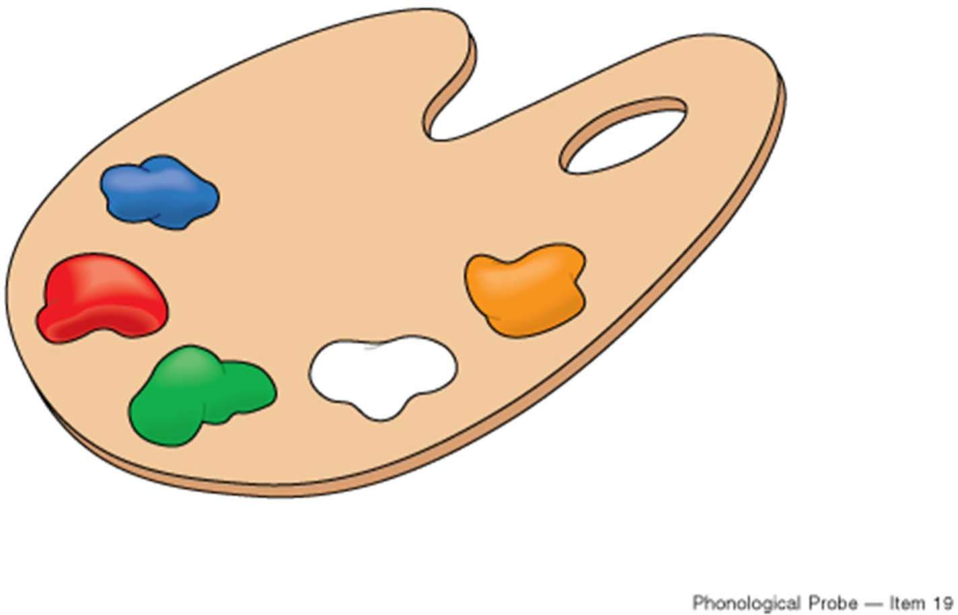
Phonological Probe – Item 19
Notes:
Red (point to red paint and ask “What color is this?”)

Slide 22
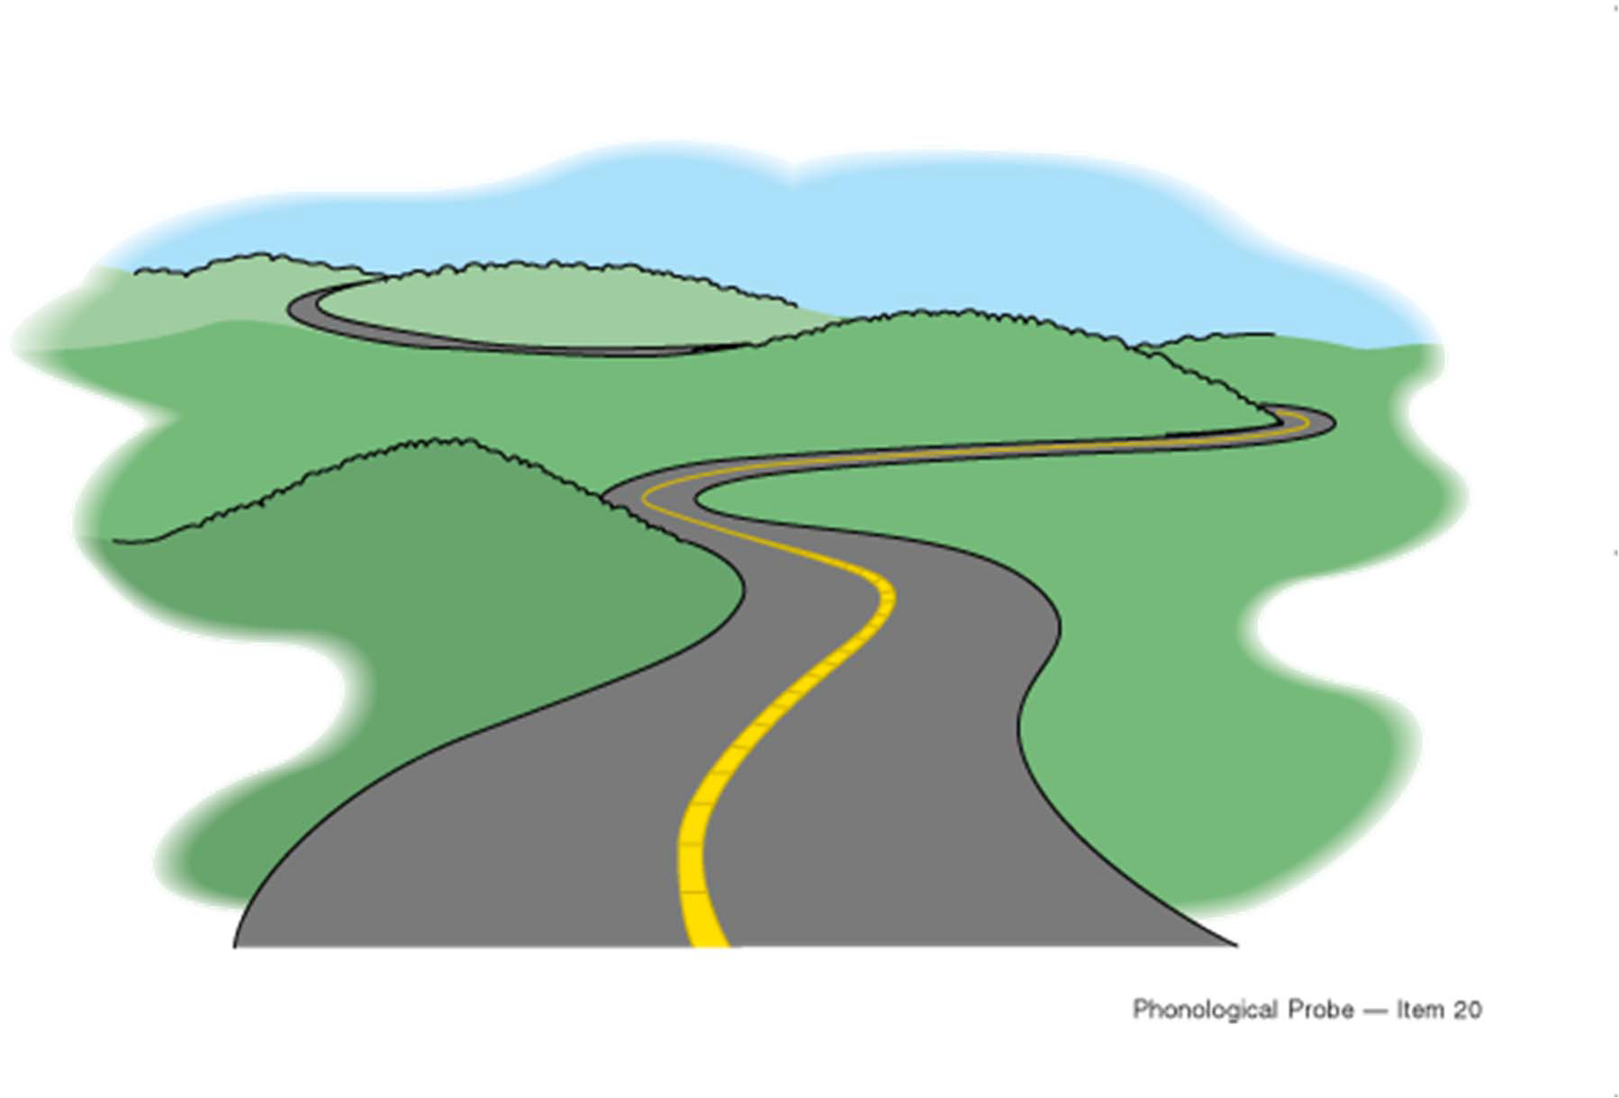
Phonological Probe – Item 20
Notes:
road

