Slide 1
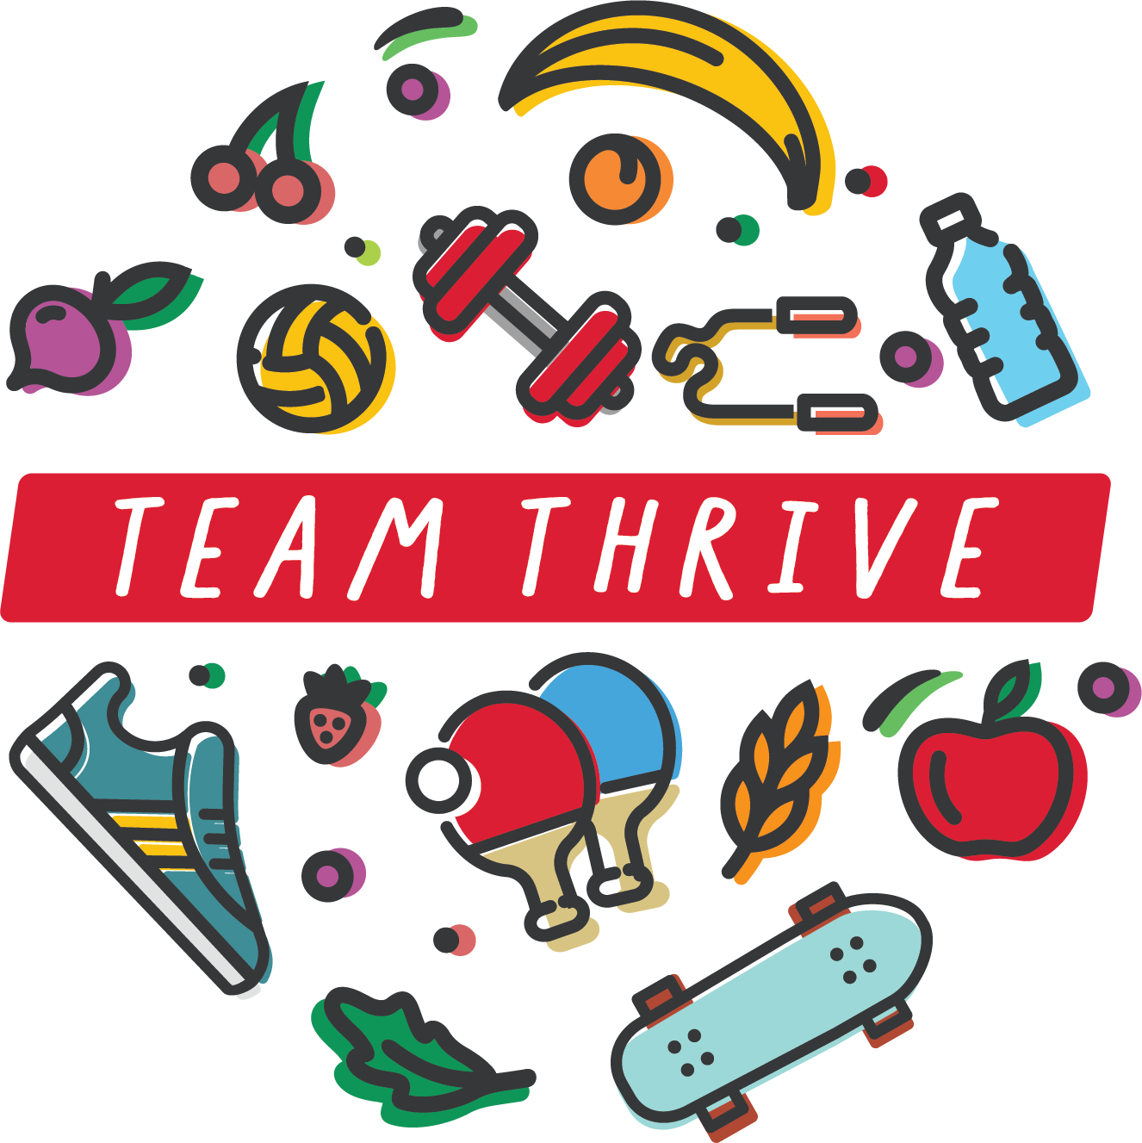
Welcome to TEAM THRIVE!
Notes:
Day 1 Introduction
This PowerPoint is meant to help introduce students to Team Thrive and the Driving Out Diabetes Initiative.

Slide 2
What does it mean to thrive?
Thrive
To flourish; to progress toward or realize a goal despite or because of circumstances
Happy
Growing and learning
Able to do what you want to do in life
Survive
To remain alive or in existence
May not be happy
Going through the motions
Unable to do what you want to do in life
Notes:
What does it mean to thrive?
Thriving means to flourish or to progress toward or realize a goal despite or because of circumstances. We all face different challenges. We all come from different backgrounds. We have different interests. We have different talents. Whatever your circumstances, goals, and talents, you probably would agree that living a happy life is important. The purpose of Team Thrive is to help give you skills to be happy and do what you want to do in life by being healthy, growing, and learning. One way is to help prevent diabetes and sickness when possible. But if you have diabetes, you are able to thrive by managing symptoms and blood glucose.
What does it mean to survive?
On the other hand, surviving simply means to remain alive or in existence. In other words, someone who is just surviving is going through the motions. They may not be happy. Ultimately, they are unable to do what they want or achieve their goals.
How is this surviving different than thriving?
Surviving doesn't bring a quality of life while thriving allows you to have purpose and joy.
References:
Merriam-Webster. Definition of Thrive. Accessed August, 2020.
Merriam-Webster. Definition of Survive. Accessed August, 2020.

Slide 3
Dr. maya Angelou
"My mission in life is not merely to survive, but to thrive; and to do so with some passion, some compassion, some humor and some style."
Notes:
Dr. Maya Angelou was an American poet, memoirist, and civil rights activist who said it best with this quote: "My mission in life is not merely to survive, but to thrive; and to do so with some passion, some compassion, some humor and some style.”
The picture on the right shows her receiving the Presidential Medal of Freedom in 2010. When she passed away, President Obama stated, “Today, Michelle and I join millions around the world in remembering one of the brightest lights of our time – a brilliant writer, a fierce friend, and a truly phenomenal woman. Over the course of her remarkable life, Maya was many things – an author, poet, civil rights activist, playwright, actress, director, composer, singer and dancer. But above all, she was a storyteller – and her greatest stories were true. A childhood of suffering and abuse actually drove her to stop speaking – but the voice she found helped generations of Americans find their rainbow amidst the clouds, and inspired the rest of us to be our best selves. In fact, she inspired my own mother to name my sister Maya.”
This is an example of someone who learned to thrive despite challenges.
References:
Hudson D. Remembering and Celebrating the Life of Dr. Maya Angelou. 2014.

Slide 4
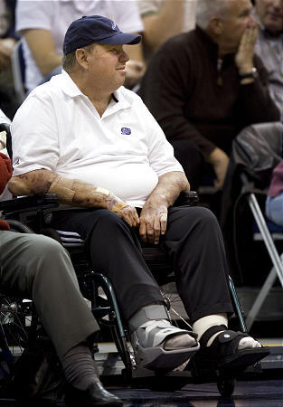
Larry H. Miller
Notes:
Who was Larry H. Miller?
He was a prominent Utah Business owner and community member, most notably of the National Basketball Association’s Utah Jazz. You may have seen his name on several other businesses like move theaters or car dealerships.
These are two pictures of Larry H. Miller. What differences can you spot between the picture on the left and the picture on the right?
Left: younger, weighs less, smiling, looks happy, etc.
Right: bandages on arms, wounds, sitting in wheelchair, unable to move around, feet in boots, overweight, looks unhappy, etc.
The picture on the right is Larry H. Miller at a Jazz NBA game after he had developed diabetes but did not manage it properly. On the left he was thriving but on the right, he was just surviving. In 2009, he died from complications of type 2 diabetes. He was 62 years old.

Slide 5
Larry H. & Gail Miller Family Foundation
Notes:
Gail Miller, his wife, was incredibly sad to lose her husband, especially from diabetes that is often preventable by making healthy choices about eating and physical activity.
After her husband died, it eventually became important to Gail to create a way to help prevent diabetes. With support from the Larry H. & Gail Miller Foundation, the University of Utah started the Driving Out Diabetes Initiative to help prevent early development of diabetes.
Team Thrive’s goal is to help you learn about the choices you can make to reduce the chance of getting diabetes and to learn about better nutrition. We are going to practice increasing physical activity, eating more fruits/vegetables, and decreasing added sugar. Starting a healthy lifestyle early will help you thrive and prepare you to accomplish your goals in life.

Slide 6
Notes:
Team Thrive staff with Forward Ekpe Udoh #33 of the Utah Jazz.

