Slide 1
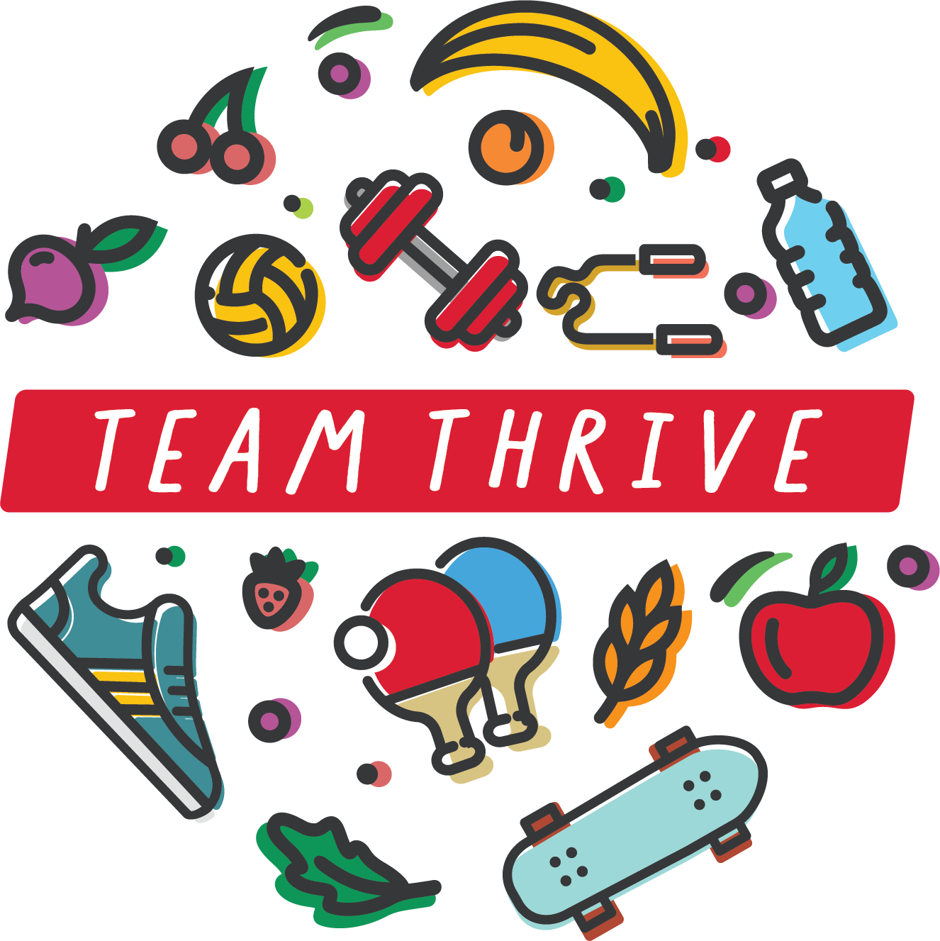
Body Image
Notes:
Day 5 Biometrics & Body Image
This PowerPoint is intended to help facilitate open discussion around body image, its influences, and ways to improve body image.

Slide 2
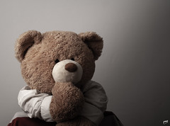
What influences your ideas of how your body should look?
Notes:
What is body image?
Body image is your mental image of your own body. This mental image may not always be accurate. It is important because it often informs what you believe about yourself or how you treat yourself. It influences how you see your physical shape or weight and your sense of control with your body movements.
What influences your ideas of how your body should look?
Influence can come from what we see on television, in movies, magazines, and in social media. This is what we call “popular culture”. It can also come from family, friends, or classmates.
Why does this matter?
Many cultures have specific ideas about what people should eat and what size and shape bodies should be.
We have been talking about ways in which we can work towards healthy lifestyle behaviors. Sometimes we think “once I change my behaviors, eat better, or lose weight, then I will like my body more.” In reality, it is often the other way around. The more we care for, respect, and accept our bodies, the more likely we are to embrace healthy lifestyle changes (healthier eating, activity, etc.).

Slide 3
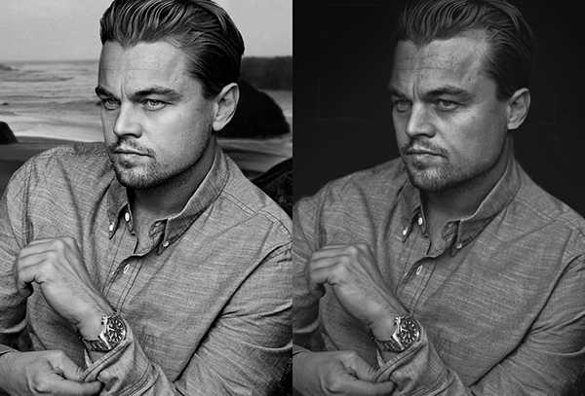
How are bodies usually presented in media?
Notes:
How are bodies usually presented in media?
Models or celebrities that have the same body type
Photoshopped or edited
Perfectly sculpted (no excess skin, toned muscles, etc.)
Skin with no flaws (no wrinkles, visible fat, red patches, freckles etc.)
Often one race
Done hair and makeup (including men)
Advertisements for products to improve a “flaw”
Only good things portrayed
Social media, in all its different forms, can often distort reality. In the picture we see a before and after shot. The photo on the right is photoshopped. Why is it important to see this?
Culture can be described in many ways, but with body image in mind, it influences what we think is commonly expected (social norms) for our appearance. Social norms are what we expect reality to be versus what the actual reality is. The social norms promoted by media are not always reality. There are a variety of body shapes and traits that should be celebrated.

Slide 4
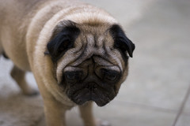
What does media tell us?
We aren’t good enough.
We need to change our bodies.
What are some consequences when we have negative perceptions of ourselves?
Notes:
What does the media tell us?
The companies that send these messages are interested in you buying their product. They are not concerned about your self-image. Often products imply that we aren’t good enough as we are and that we need to change our bodies to feel satisfied.
What are some consequence when we have negative perceptions of ourselves?
Body dissatisfaction (feelings of anxiety, shame, self-consciousness) can contribute to depression, low self-esteem, or even eating disorders while body satisfaction can contribute to acceptance of self, confidence, and respect for what our bodies can do.
Eating disorders are diagnosed by qualified health professionals according the the DSM-5 criteria and can include anorexia nervosa, bulimia, and binge eating disorder. Eating disorders occur in both men and women.
Disordered eating can have a large range of descriptions, but may be identified as unhealthy approaches to eating food.
Some signs of disordered eating include:
Eliminating or avoiding certain foods
Eating in secret or skipping meals
Feeling anxiety, guilt, or shame around food and eating
Not having a sense of control
Finding ways to “make up” for bad foods
Having ridged rules around food or exercise

Slide 5
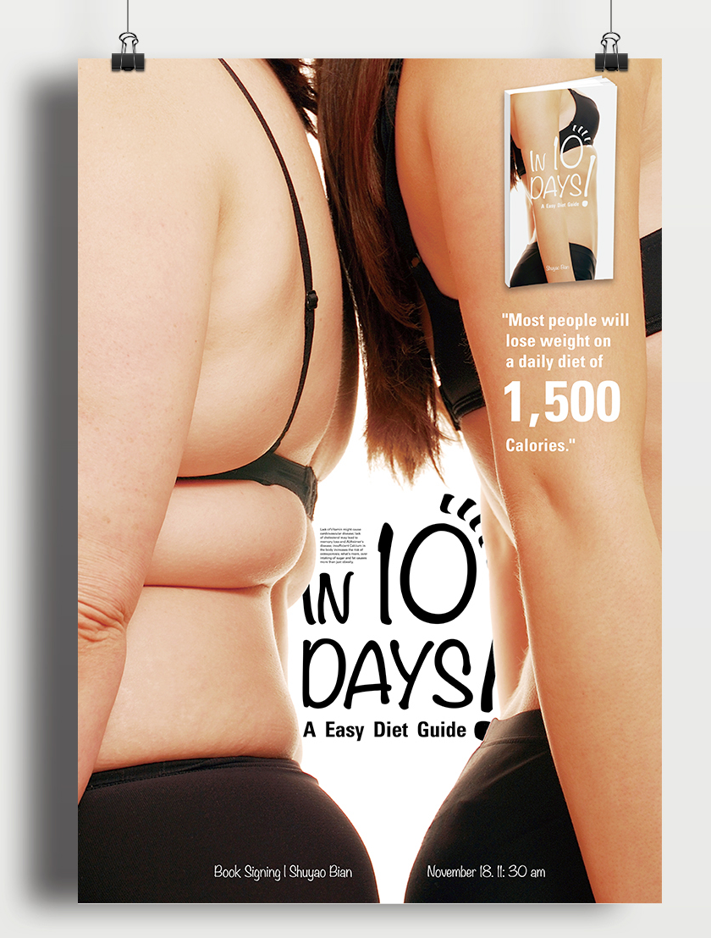
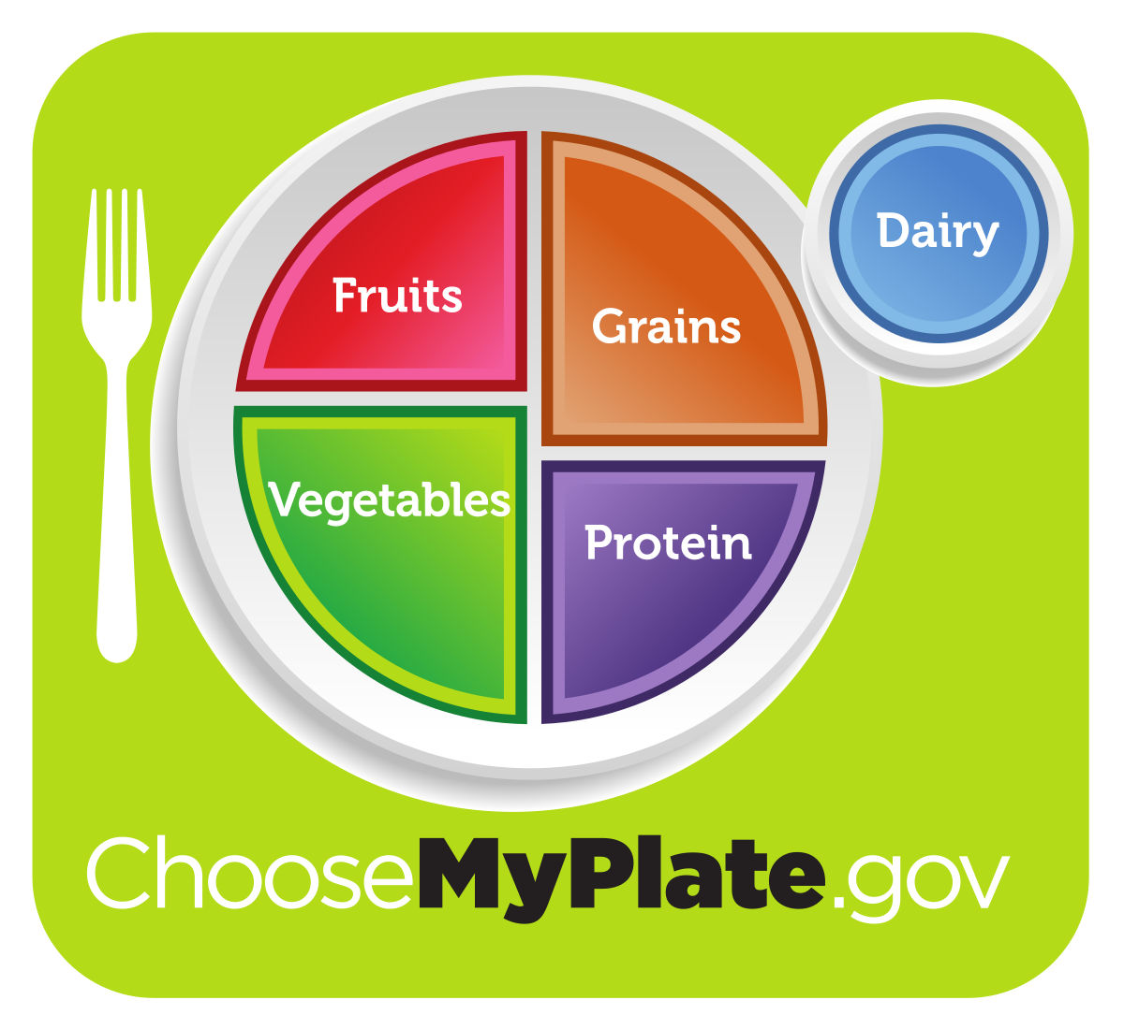
What influences your food choices?
Notes:
A culture’s concept of body image will influence what is marketed and advertised within communities. This is often applied to food. What influences your food choices and what you eat?
Example:
Fat is seen as being “bad” – men generally want to get bigger by gaining more muscle and losing fat. Women generally want to be smaller and less fat overall. However, eating fat does not make you fat. Remember, fat is a necessary nutrient and healthy fats will not necessarily lead to more body fat.
Eating meat might been seen as something men do. Men are told to think they need to be more muscular. This implies they need to consume more protein to gain muscle. This is because muscle is partially built by protein. So, men are taught that they should eat more protein to build more muscles. This is generally thought of as achieved through consuming meat. However, there are also many plant-based sources of protein.
On the other hand, eating a green salad is sometimes seen as something women do. Why? Similar to ideas about men’s bodies, women are often told through media that they should be smaller and have less fat. The idea is that eating fewer calories (or dieting) and less dietary fat will make women smaller and have less body fat. However, this isn’t true.
Marketing and advertisements can promote extremes in eating patterns. This can be through fad diets, food rules (rules telling us what, when, why, or how to eat), or supplements. What we want to focus on is more moderate, varied, and balanced nutritional approaches (such as MyPlate). Think about fueling your body to do what you want to do in life (thriving)! This can support a healthier relationship with food and a more positive influence on body image.
When we have a distorted idea of what body image should be, it can create a dangerous cycle and influence what we eat and can cause negative health consequences (such as dieting or disordered eating).

Slide 6
What does this look like around the world?
Notes:
American culture has taught us what an “attractive person” should look like, but what is considered “attractive” can vary between countries and regions. What does this look like around the world?
Examples:
Different types of diets
Larger bodies are better
Hourglass or barrel shapes
Light/pale skin is beautiful; a status symbol
Showing skin or covering it
Long, thick hair or various hair colors
Soft facial features or strong facial features

Slide 7
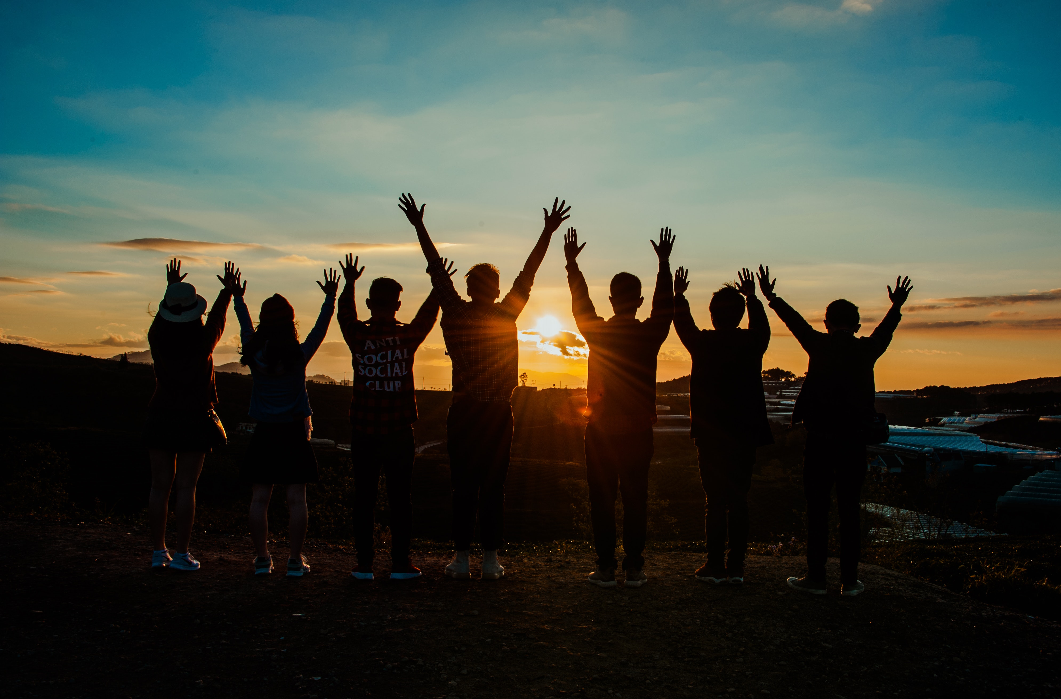
Family & friends
Notes:
Friends and family have a large influence on how we act and what we look like. They influence what we eat on a daily basis. What are some examples?
Parents/guardians: may be constantly dieting, comment about appearances, provide the food available (shopping and cooking), specific taste preferences
Friends: getting fast food every day at lunch, going to coffee shops or convenience stores, ordering similar foods, feeling pressure/stigma around certain foods
How do our family genetics play a role?
Our genes can determine our body shape and how we lose or gain weight. This is important to consider when we think about how we may want our bodies to look.
When we are constantly putting ourselves down and feeling shame around food, we have a more negative body image. Reframing our thoughts and self-talk can help us have a realistic view of our bodies and food.

Slide 8
How do we have positive a body image?
Become aware of external influences on your idea of body image and reevaluate those ideas.
Recognize that a variety of body shapes and traits exists.
Focus on how your body feels, moves, and works.
Think about your body from a health perspective. Remember the energy and nutrients your body needs.
Be kind to yourself and your peers.
Notes:
How do we have a positive body image?
Once we recognize what influences our body image, we need to take a step back and reevaluate how we look and think about ourselves. Think about their own body image and describe how you see your body to yourself.
Think about the influences have affected your own body image. Are they accurate? Are they true? What are your emotions when thinking about this?
If you do have a positive body image, what steps did you take to get to that point?
If you do not have a positive body image, what could you do to work towards a positive body image?

Slide 9
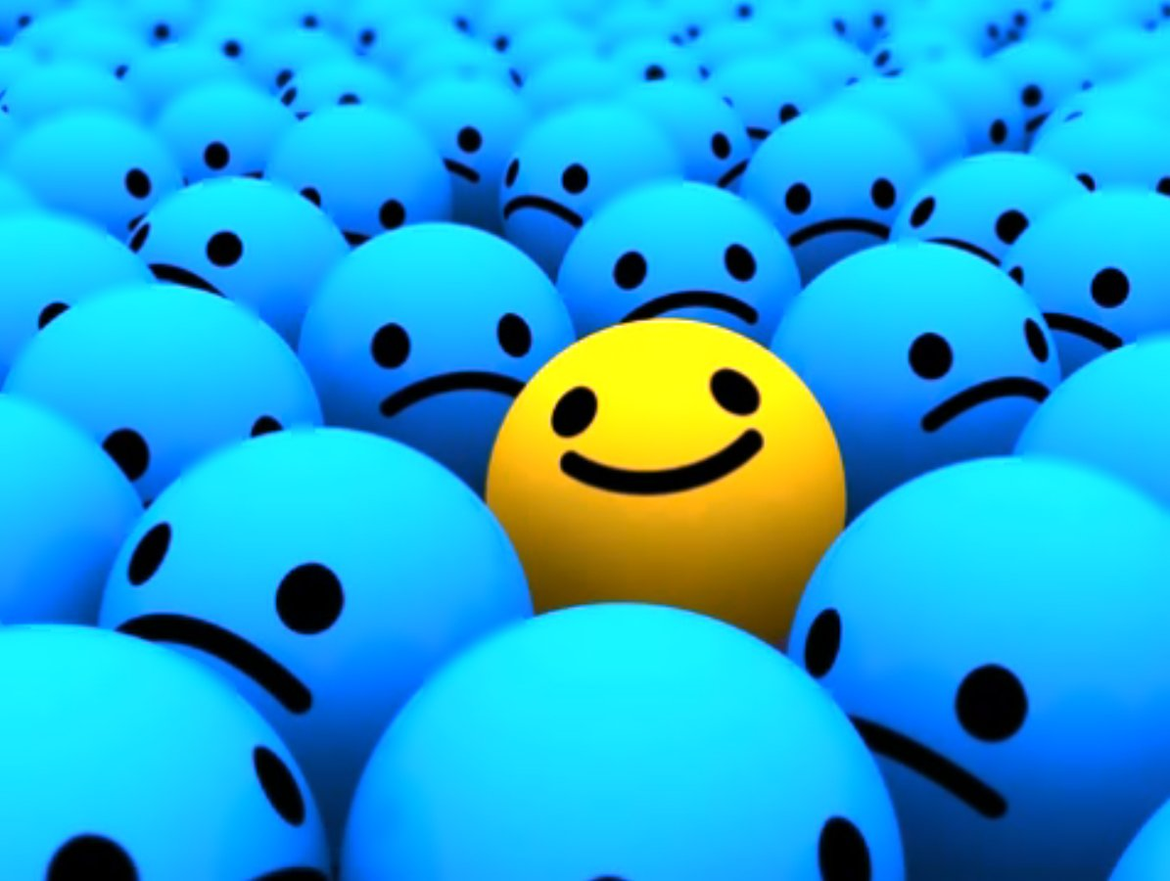
Be Proud of Who you Are
Focus on characteristics, interests, and skills that make you who you are.
Focus on who you want to be, not what others want you to be.
Notes:
Be proud of who you are and practice positive self-talk. Notice, the word practice. This means it takes trial and error and repetition. Having a positive body image isn’t always easy. When we can improve the way that we think about ourselves, we can grow in confidence and love for what our bodies are capable of. We can focus on the things that our bodies can do (versus the things that they can’t), reaffirming the things that we like about ourselves.

